Slide 1

The images used in this presentation have been purchased or created by DDWA and cannot be reused for any other purpose.
Thank you for respecting this copyright notice.

Slide 2

Staying Connected After School
Session 2

Slide 3

Who is DDWA?
Notes:
DDWA- Supporting people with developmental disabilities and their families since 1985

Slide 4
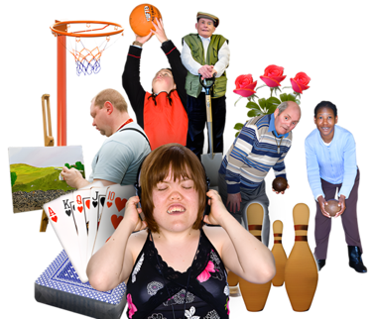

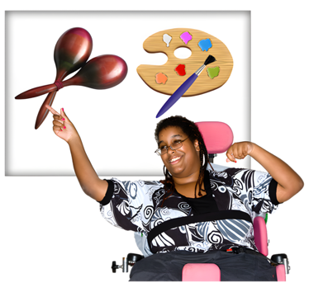
What are we talking about today?
How we can fill our days after we leave school with hobbies, work, or more learning.
How we can plan and use public transport to meet up with our friends.
What activities and groups are available in our communities.

Slide 5

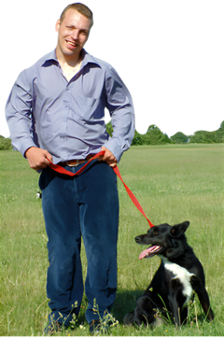

There are lots of things you can do after you leave school
Look for a job.
Do volunteer work.
Join a club.
Notes:
Suggestion: Expand on ‘join a club’ - this could be a sporting club, art club, dungeons and dragons, gym, volunteering

Slide 6
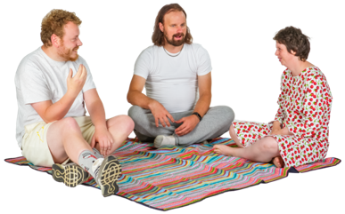

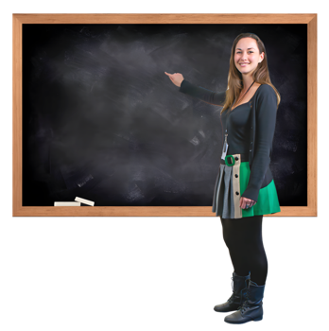
There are lots of things you can do after you leave school
See your friends.
Relax.
Learn more by going to Tafe or doing other courses.

Slide 7

What do you want to do when you finish school?
Notes:
Ask the students to share ideas about what they would like to do post-school.
You can encourage students to talk about hobbies that they enjoy doing and may want to continue after they finish school.

Slide 8
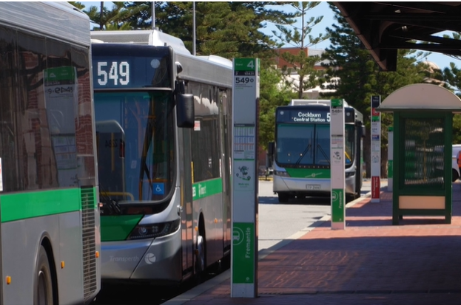
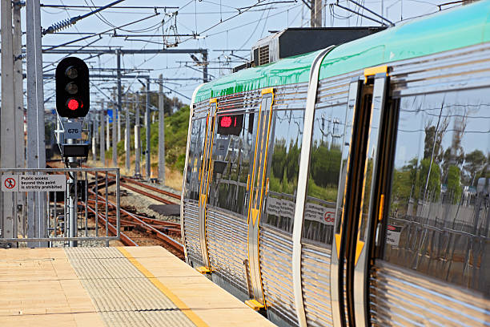
Transport
How will you get around to try out all these new things?
What are different forms of transport that you can use to get to new places?
Notes:
Get students to brainstorm different ways to get around.
There are examples on the next few slides.

Slide 9

Public transport
There are many different types of public transport.
  Buses
  Trains
  Trams
  Ferries
  Rideshare services like Uber
Using public transport can help you to do more things.
Notes:
Discussion question:
“Who has used public transport before?”
Activity (optional)
Get students to search how they could get home from school using Transperth Journey Planner.
https://www.transperth.wa.gov.au/Journey-Planner

Slide 10
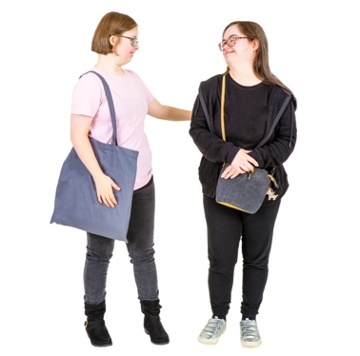
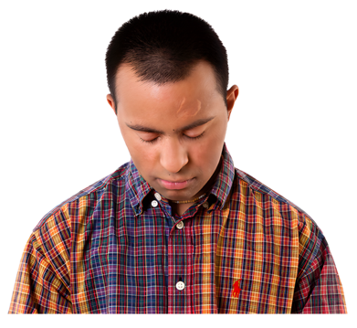
Public transport
Meeting up with our friends is important after we leave school.
Catching public transport is a good way to meet up with friends.
For some people using a train or a bus can be tricky.
Notes:
Discussion question:
Does anyone want to share a story about an experience that they have had on public transport before?

Slide 11
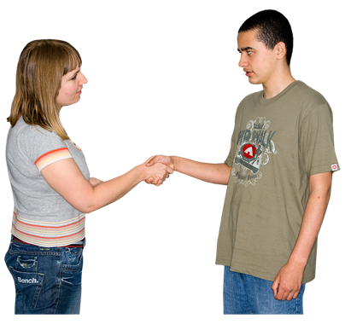
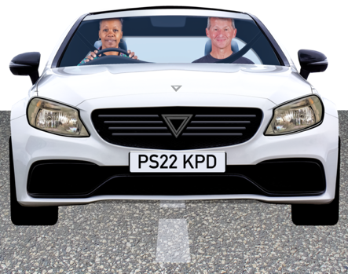
Public transport
Your support worker or a trusted adult could help you learn how to use public transport.
Some people have a support worker, parent or carer to take them places.
Notes:
Discussion question:
Does anyone have a support worker who takes them places?

Slide 12
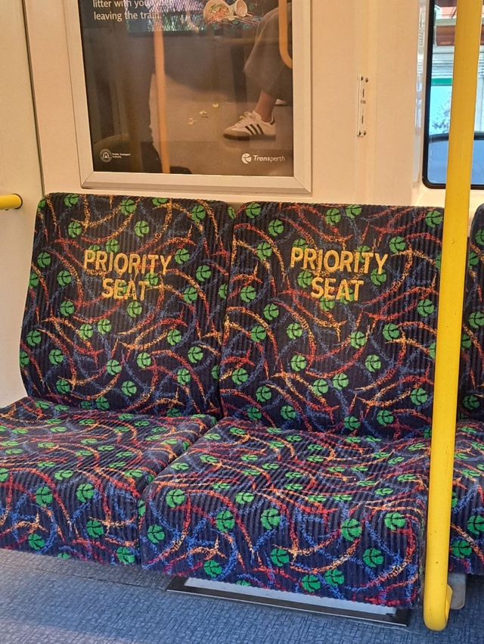
Using public transport
Who has used public transport before to get to a new place?

Slide 13
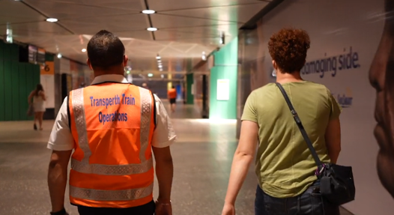
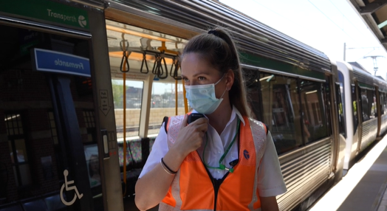
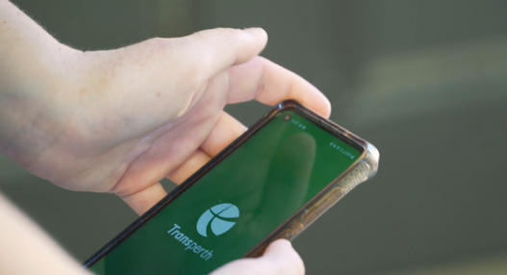
Transperth Special Assistance Line
There are workers to help at train stations. They can help you take the right train and get off at the right place.
This is called the Transperth Special Assistance Line.
There are apps to help you plan a journey and use public transport.
Notes:
After this slide: We are now going to watch a video that is called “Catching public transport to meet a friend.”

Slide 14
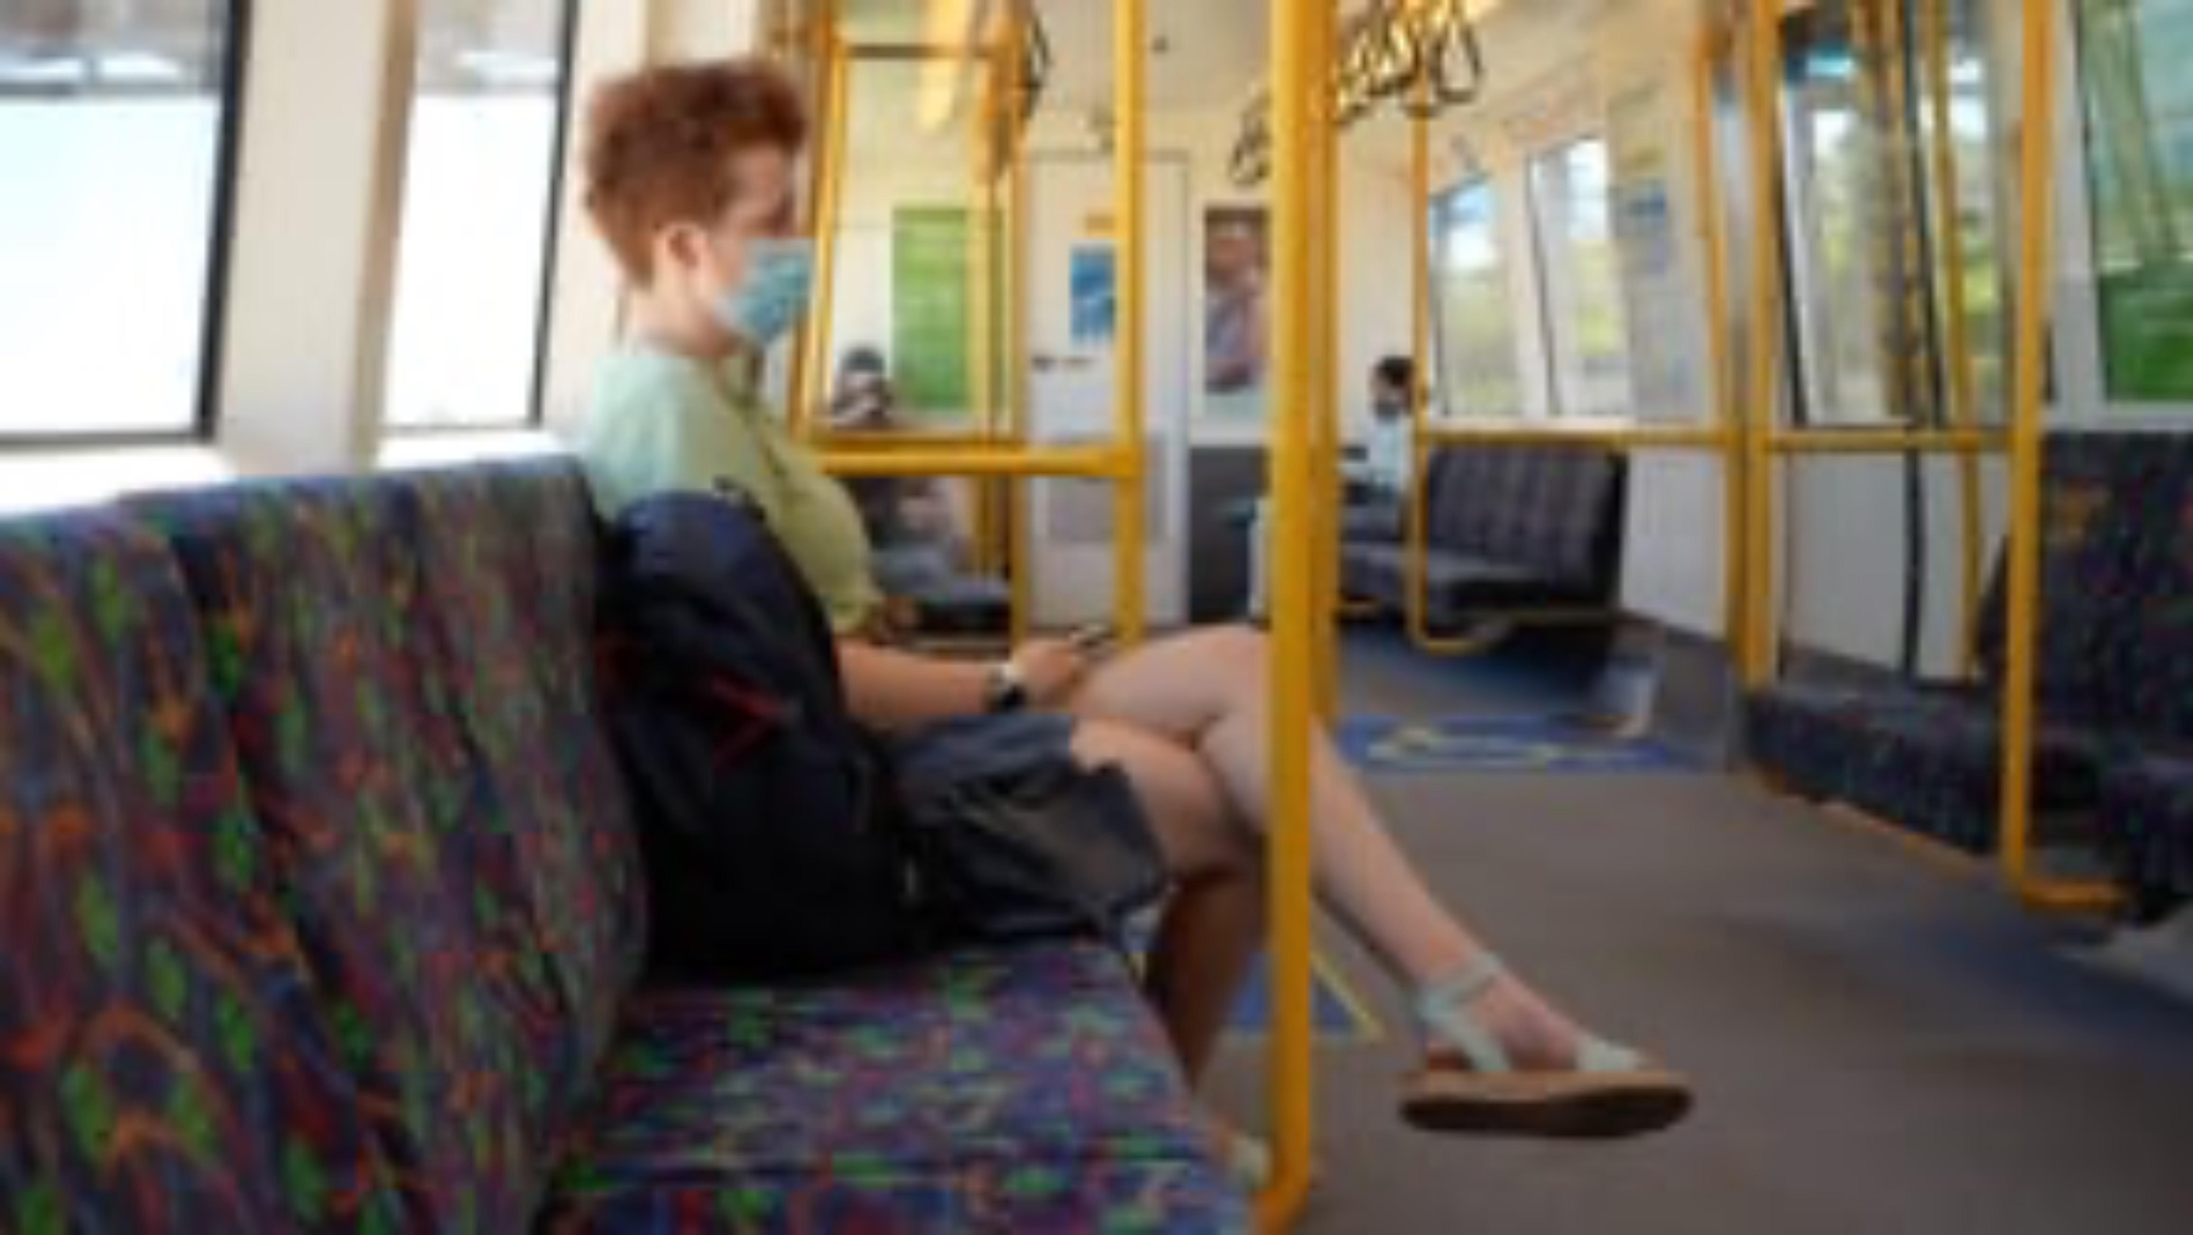
Notes:
Video: Catching public transport to meet a friend
Key messages in this video:
Spending time together is important to grow a friendship
Catching public transport is a good way to meet up with friends.
There are workers to assist at train stations. They can help you take the right train and get off at the right place.
There are apps to help you plan a journey and use transport.
Link to access the video:
https://ddwa.org.au/online-learning-directory/the-friendship-project/

Slide 15
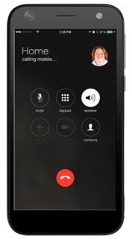
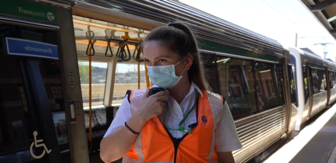
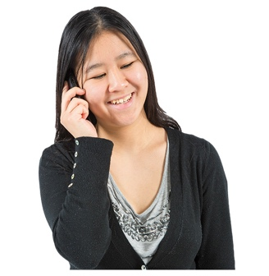

Transperth Special Assistance Line
Phone number is 1800 800 022.
There are staff members who can help you at all stations.
Call one hour ahead of your journey.
The Transperth staff will help you with getting on and off the train.
Notes:
Discussion question:
Has anyone ever heard or used the Transperth Special Assistance Line before?
Does anyone want to try it after watching that video?
You can find more information about the Transperth Special Assistance line here https://getonboard.transperth.wa.gov.au/Parents/Special-Assistance

Slide 16
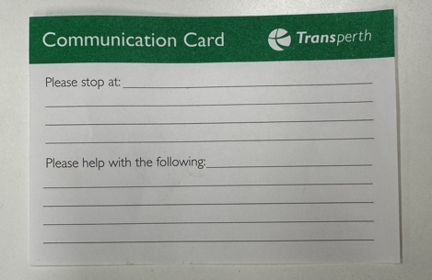


Communication card
You can use communication cards to tell Transperth staff how to help you.
Show your communication card to the bus driver as you get on the bus.
You can get communication cards by calling 13 62 13 or from any Transperth InfoCentre.
Notes:
Mainly used on the bus but also could be used on the train if you need to communicate that you need help with something.

Slide 17


Planning to meet up with a friend
We have looked at how we can use public transport to get to places.
Now let’s look at how we can plan what we are going to do with our friends.

Slide 18


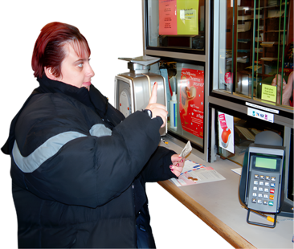
Planning to meet up with a friend
Make it a day and time when you can both do it.
Think about how you will get there.
Think about what it will cost and who might need to go with you.
Notes:
You might like to use a friendship planner - displayed on the next slide.

Slide 19
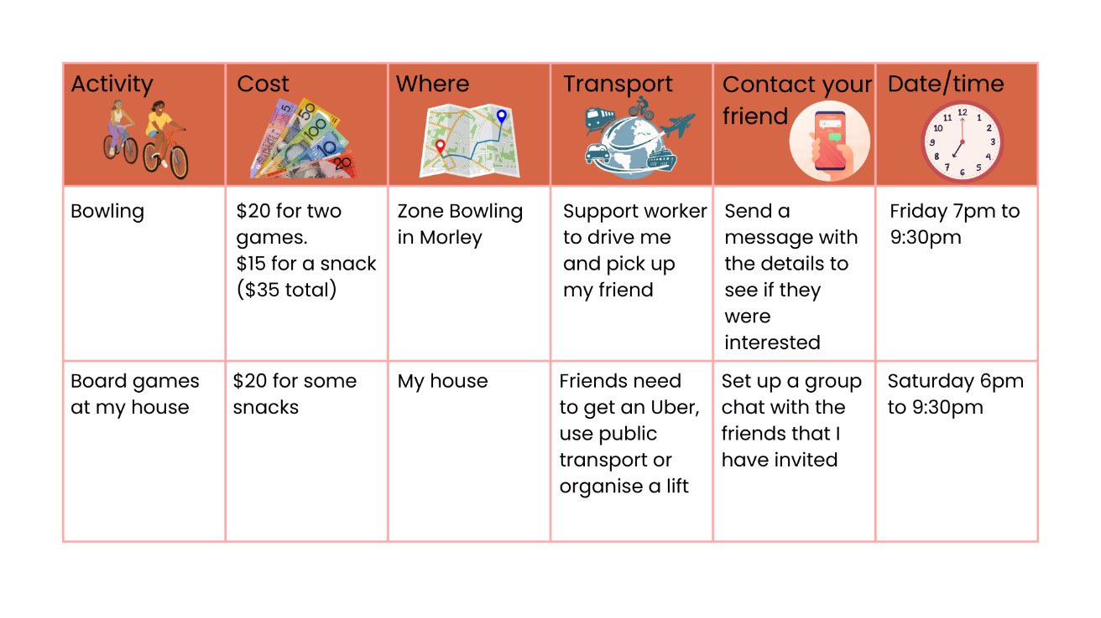
My Friendship Planner
Notes:
Go through the Friendship Planner with the students to break down the activity and what needs to be considered when organising a catch up.
There is a blank Friendship Planner on the next slide, it is also displayed in the students' booklets on page 53.

Slide 20
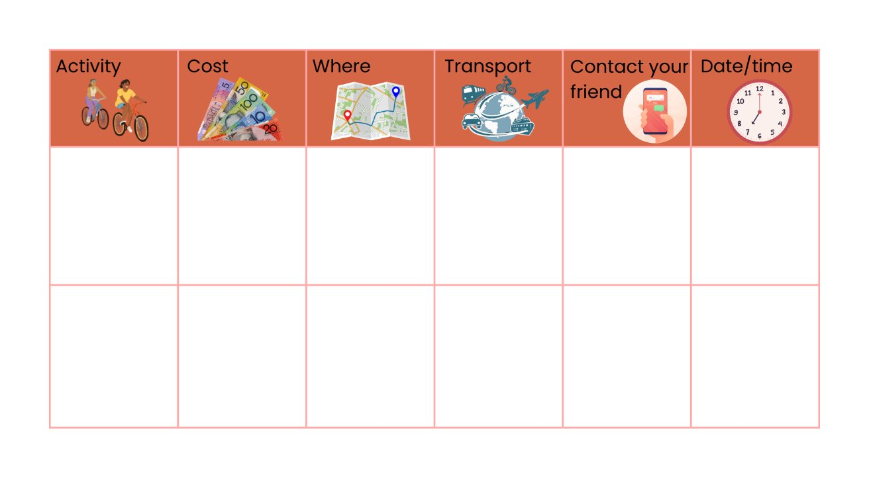
My Friendship Planner
You can use this blank planner to think of some activities that you might like to do with your friends.
You could ask your family or a support worker to help make it happen☺
Notes:
Students can use this the next time that they are arranging a catch up with a friend – you could get the students to fill it out during class time.

Slide 21
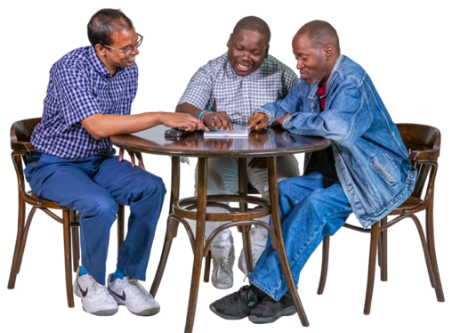
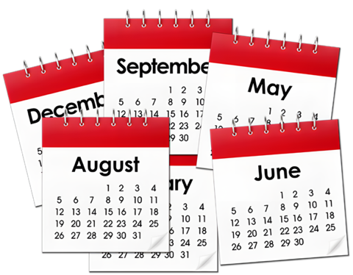
Planning to meet with a friend
Someone in your family can help you think about when you could see your friend.
It does not have to be every week but maybe once a month.

Slide 22
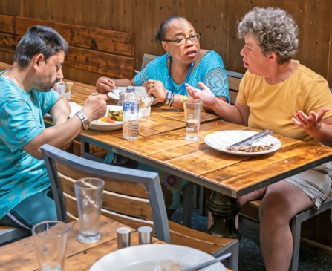

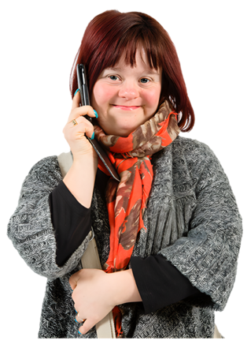
My Friendship Planner - Activity
                What is something you would like to do?
                Think about
                A place to meet.
                A way to get there.
                How do you invite others?
Notes:
Whole group activity
Use a whiteboard to write down students' ideas
Get them to think about what they need to bring, for example, if they are catching public transport, they need to bring their smart rider
Example
A place to meet – Hillary’s Boat Harbour
A way to get there – Organise a life with my support worker, ask if my friend would like us to pick them up on the way
How do you invite others? – Over the phone, message into the group chat to see who is free and arrange a time to meet up
Will there be food there? – Yes, there are lots of food options at Hillary’s Marina, such as restaurants and take-away food vendors.
You could also divide the students up into groups and get them to complete it independently before sharing their ideas with the whole group.
More questions on the next slide.

Slide 23
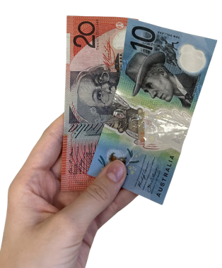
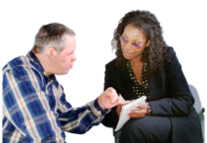
My Friendship Planner - Activity
                Do you need any money for the activity?
                Who can help you make it happen?
Notes:
Do you need any money for the activity? – Yes, we will need to bring money to be able to buy some food.
Who can help make it happen? – Your parent/career or support worker can help make it happen. They can help you to organise the outing and make sure that you have all the details sorted out.

Slide 24
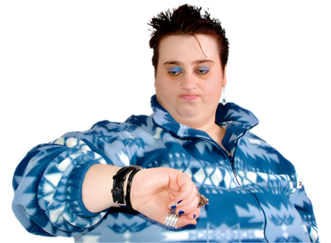
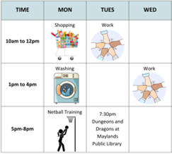

Planning to meet up with a friend
  It is not always easy to find time to meet your friends.
  Have a look at your schedule and see if you can make a plan!
  Why not put a meet up with a friend in your weekly plan, even if it is once a month.
Notes:
There is an example of a weekly plan on the next slide.

Slide 25
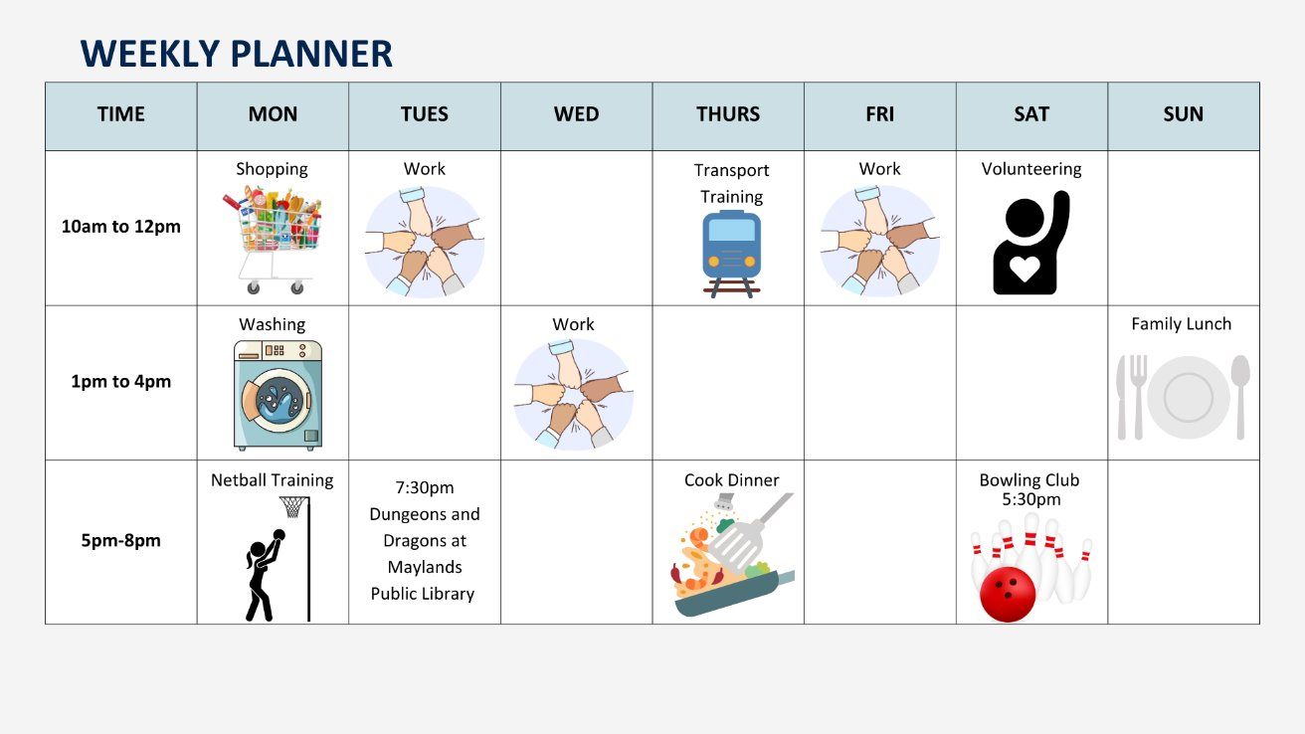
My Weekly Planner
This is what your weekly timetable might look like.
Think about some of the spaces in your week where you could maybe see a friend?
Notes:
Read through the example weekly plan, get the students to start thinking about how they can adapt it to fit in with their schedule.
Ask the students “Where is there a gap in this weekly plan to meet up with a friend?”
Discussion Question:
Where are some places that we can find out what activities are being offered in our community?
Some answers can include:
Local council website – search for their ‘event planner’ (we will talk more about local councils later)
Facebook/social media
Word of mouth (through friends and family)
Google search e.g. if you are interested in joining a yoga class you could search ‘free yoga in Perth’.

Slide 26
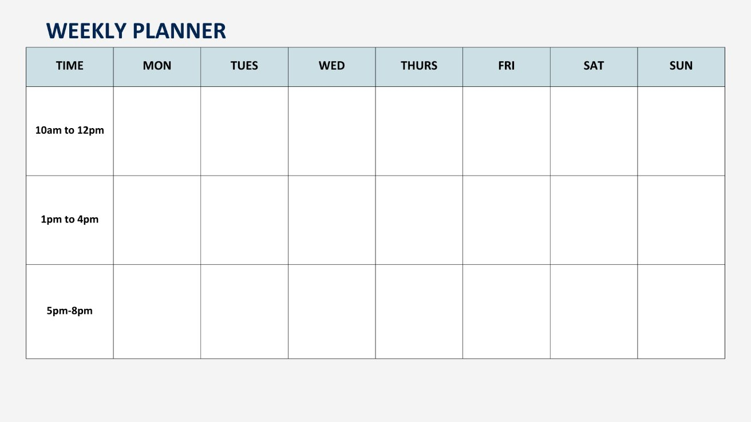
Notes:
Discussion question:
Where are some places that we can find out what activities that are being offered in our community?
Students can fill this out in their own time, or you could ask them to complete it in class.

Slide 27
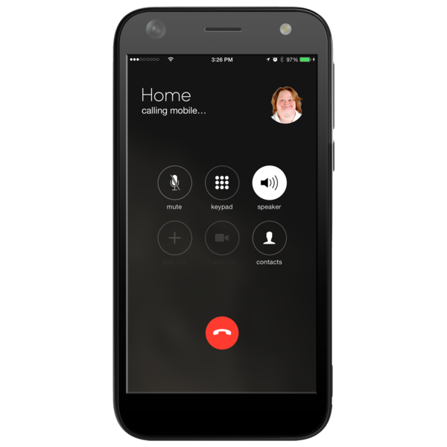
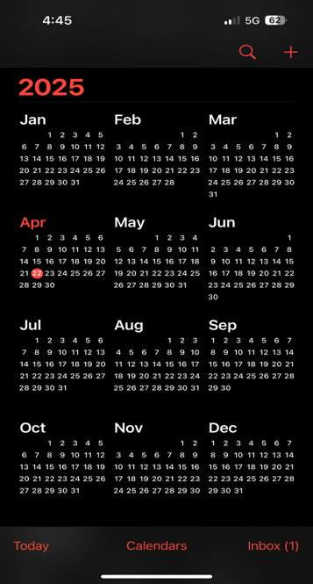
My Weekly Planner
You can also use the calendar on your phone.
There are free apps that you can download and use.
An example is Google Calendar!
Notes:
Discussion question:
Who uses a calendar? This can either be an electronic calendar or a physical one.
If you don’t use a calendar, what are other ways that stay organised or remember what you have on?
Some people ask the person that they are meeting up with to text them beforehand
Some people stick reminders up on their fridge
Some people set reminders on their phones

Slide 28

My local council
Who is your local council?
Notes:
Find out who the local council is for the location of the school e.g. The City of Joondalup.
You can add a picture of the logo if you would like.

Slide 29
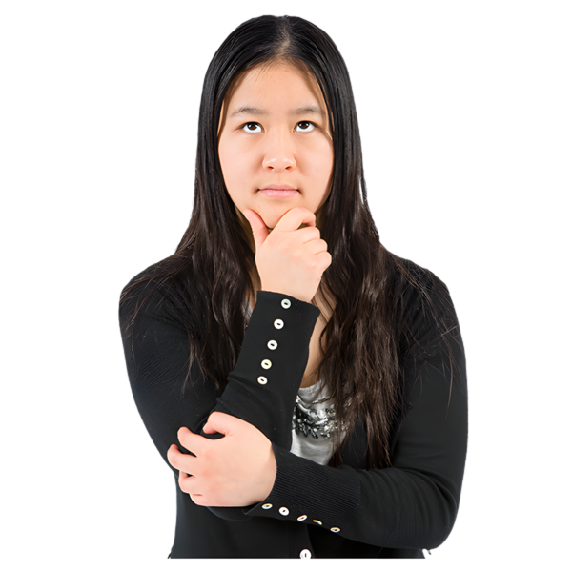
Local council
What do they do?
Notes:
The next slide runs through some of the responsibilities of the local council.

Slide 30
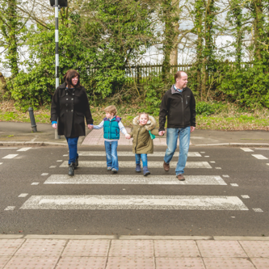
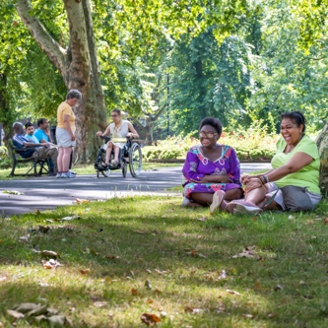

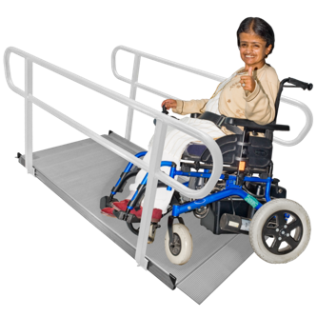
Local council
Local councils look after our roads, footpaths and rubbish.
Parks, sporting fields, stadiums and swimming pools.
Libraries, art galleries and museums.
Accessible buildings.
Notes:
The roles and responsibilities of local government differs from state to state but generally include some of the following….

Slide 31

My local council
Why does it matter to me?
Notes:
Discussion question:
Why do you think it is important to know about your local council?
Answers on the next slide

Slide 32



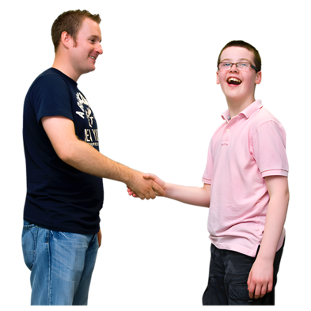
My local council
They often put on activities that you can join in.
Some of these activities are free.
You might have to pay for some activities – this is why it is important to plan ahead of time.
At events in our community, we can meet new people and meeting new people is the first step in making new friends.

Slide 33


Activities in my local council
You can find out more by going to the local council’s website.
You could ask a trusted adult or friend to help you if you need!
Notes:
Suggestion: search for the local council website on the smart board and show students where you can find upcoming events.
You can explore the website with the students and point out any useful links/resources.
This is where you can organise a representative from your local council to talk about what they have to offer. See template email. When we delivered the project in schools the council representative would come and talk about what activities and groups are on offer for the students to join now or when they leave school.

Slide 34

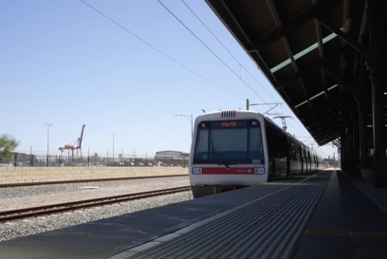
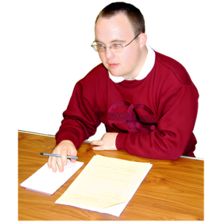

What have we learnt today?
Different things that you can do after you finish school.
Using public transport can help us to meet up with our friends.
Planning can help us make time to see our friends.
About our local council and what that they have to offer us.
Local Council

Slide 35

Thank you for being part of Staying Connected After School Project!

