Slide 1
Title screen with the name of your council
Can add a picture of your logo

Slide 2

City of ……………………….
Insert a map showing the suburbs that your City covers.
Include some information about
  How many suburbs are in the council
  What is in this mix e.g.
  houses,
  farms,
  industry and business,
  bushland and forests etc.

Slide 3

Who we are
List the amount of people that live in the city
Number of high school students
Number of young people (aged between 18-24 years) who live in the city area

Slide 4
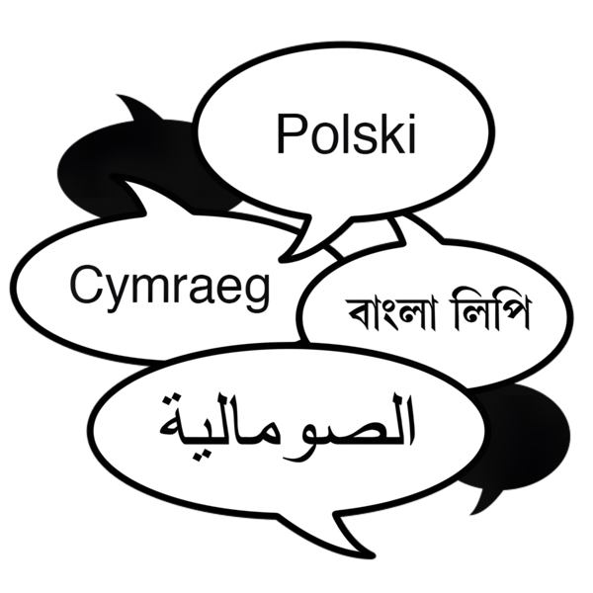
Who we are
Amount of people born overseas
Insert information about the languages spoken in your city

Slide 5
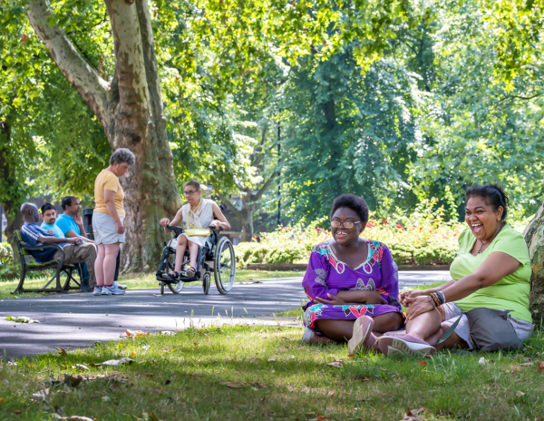

What we do
We look after people, places and spaces
  # parks, gardens,
  # wetlands, bushes,
  # sporting parks and venues
We collect rubbish, recycling etc.

Slide 6


What we do
We look after buildings for everyone to use. Mention what buildings that you look after e.g.
# playgrounds
# museums
# libraries
# Youth Centre
# swimming centres and
# sporting centres

Slide 7

What we do
Why should the students know about the council

Slide 8
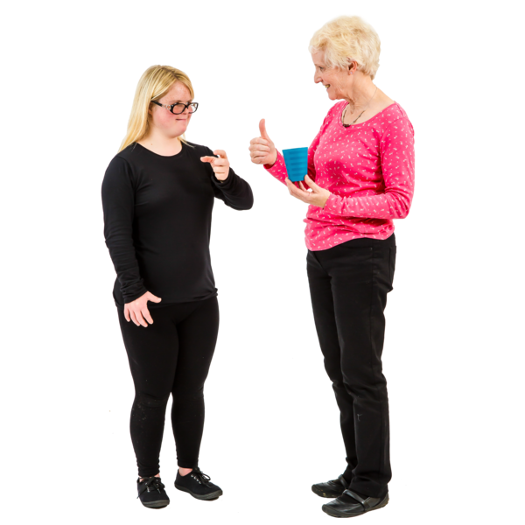

How we work
Who do you work with?
How do you make things happen?
Is there any community involvement?

Slide 9

What about YOU?
A chance to ask the students what they want to see happen in their community.
Note: Councils have found this a good opportunity to provide them with feedback about the activities that young people would like to see in their local community.

Slide 10

What you can do now
Include activities about what is available in your city
E.g. library activities, swimming centres, youth groups, holiday programs, other youth services, food markets, dance groups etc

Slide 11
What you can do now
You can provide examples of things that are currently available to young people.
Great to include if a support worker can or cannot attend with the young person.

Slide 12

Why we do it
Why does your council provide these activities and opportunities for young people?

Slide 13


What next?
How to join up to be involved in events happening
Who to contact/how to contact
Tell us what you want – we can help you find it
Information about socials and how to subscribe to get the latest information

