Slide 1

Staying Connected After School
Notes:
Might need a name change???

Slide 2
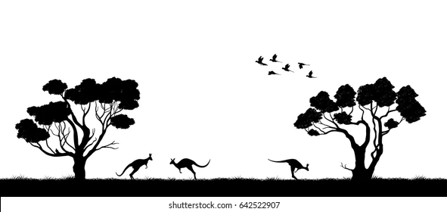



We are here on special land.
It is Aboriginal land.
It is Whadjuk land.
The Whadjuk people were the first people on this land.
Whadjuk Elders are important people.
They know how to look after this land and its stories.
They have always looked after this special land.
Thank you Whadjuk people.
Thank you Whadjuk Elders of long ago.
Thank you Whadjuk Elders of today.

Slide 3

Who is DDWA ?
Notes:
DDWA- Supporting people with developmental disabilities and their families since 1985
Introduce presenters

Slide 4
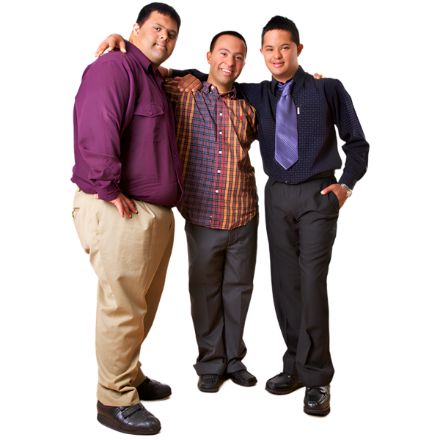
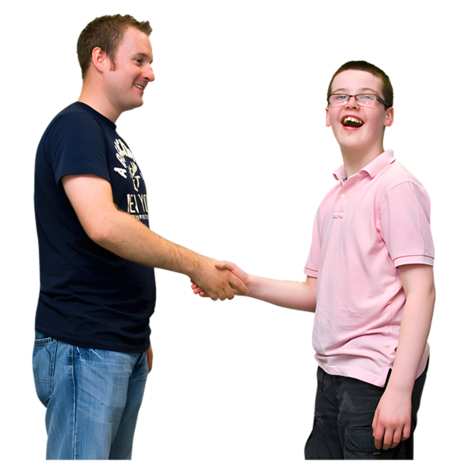
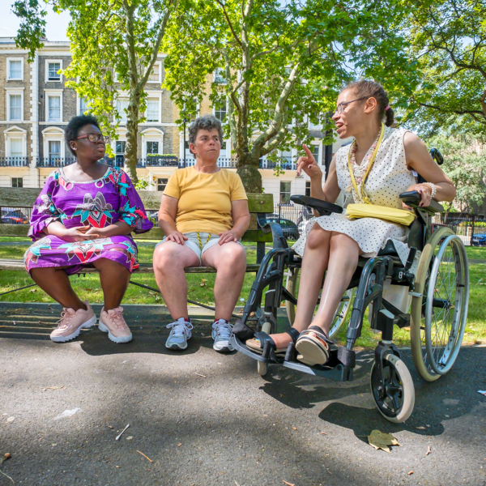
What will we learn today?
  How to keep friends from school
  How to make new friends after school
  What we can do with our friends
Notes:
Staying Connected After School is a program where we will look at
How to keep our friends from school
(Planning and using public transport to meet up with friends)
What we can do with our friends near where we live through our local council.

Slide 5

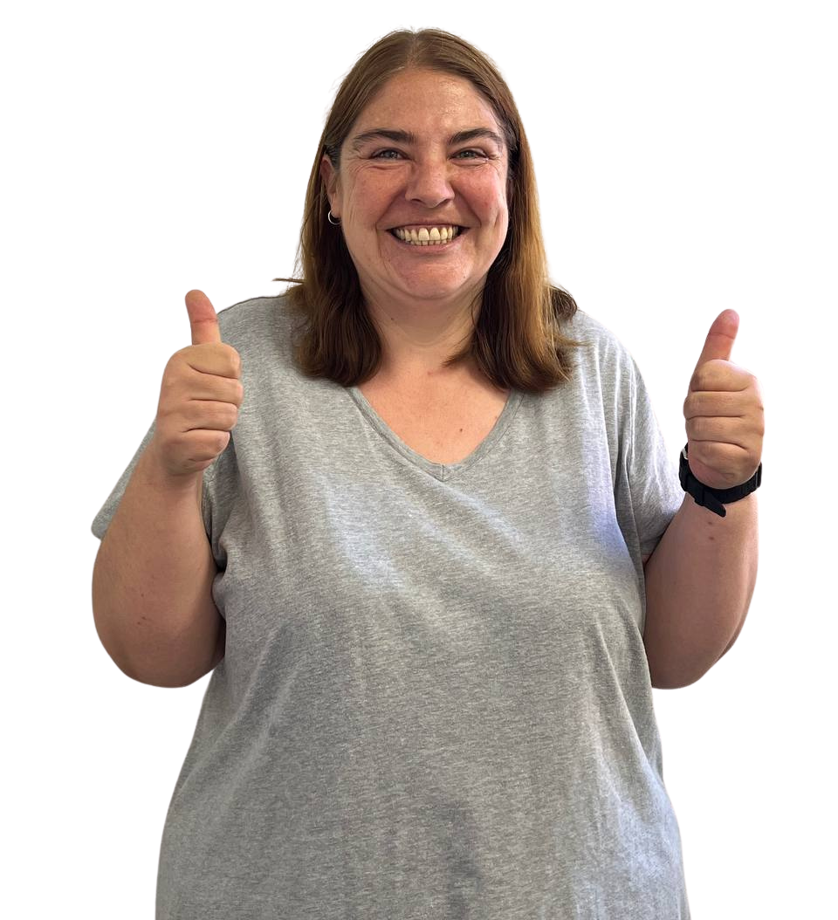
First let's get to know each other!
Hello!
How do you say hello?
How do you show you like or don't like something?
Notes:
Say name to the whole group and then talk about something they enjoy doing with a peer and then share with the whole group.
Presenters start and introduce something about themselves to help break the ice.
SURVEYS AFTER THIS SLIDE.

Slide 6
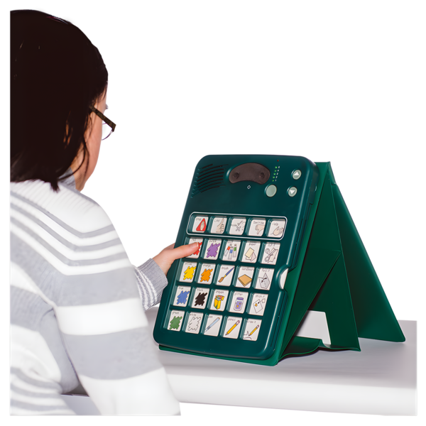
Today, you can always
Use any way that feels right to you to share how you feel or what you think with us
Your voice
Your signs
AAC devices
AAC books or boards
Switches
Your body
Notes:
Say name to the whole group and then talk about something they enjoy doing with a peer and then share with the whole group.
Presenters start and introduce something about themselves to help break the ice.
SURVEYS AFTER THIS SLIDE.

Slide 7
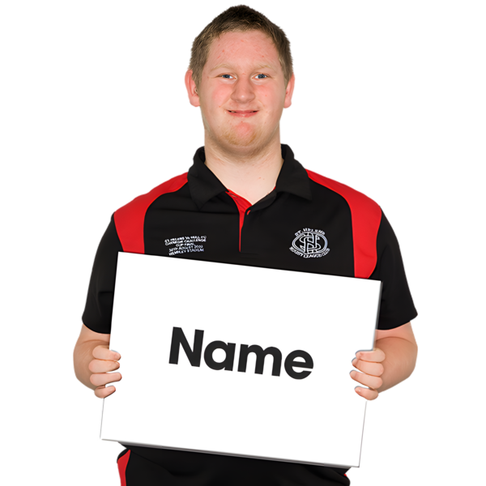
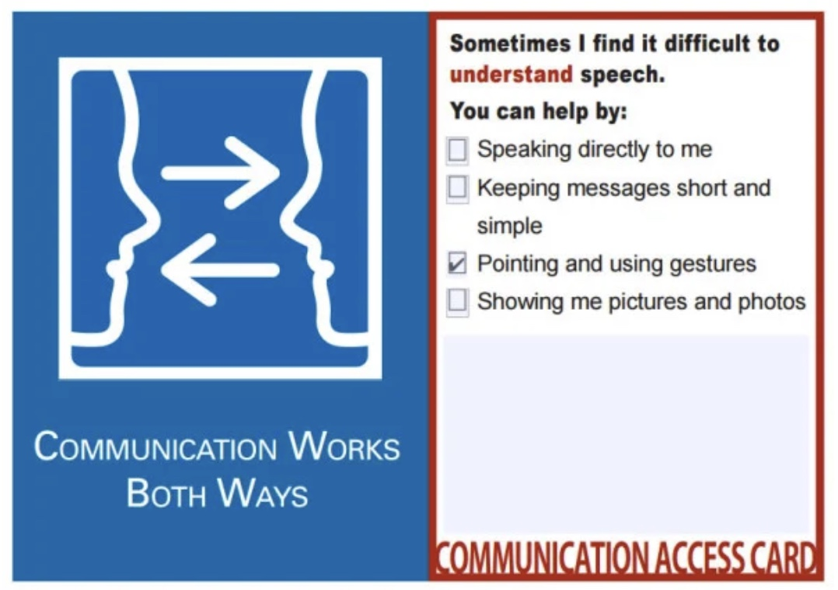
Hello, What's your name?
Do you have a way to tell people your name?
Is there somewhere on your device?
Do you have a contact card?
Notes:
Say name to the whole group and then talk about something they enjoy doing with a peer and then share with the whole group.
Presenters start and introduce something about themselves to help break the ice.
SURVEYS AFTER THIS SLIDE.

Slide 8
What will we learn today?
  How to keep friends from school
Notes:
Staying Connected After School is a program where we will look at
How to keep our friends from school
(Planning and using public transport to meet up with friends)
What we can do with our friends near where we live through our local council.

Slide 9
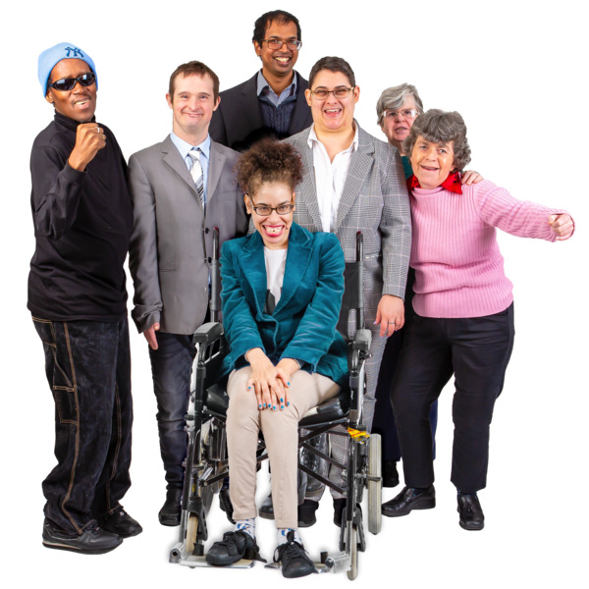
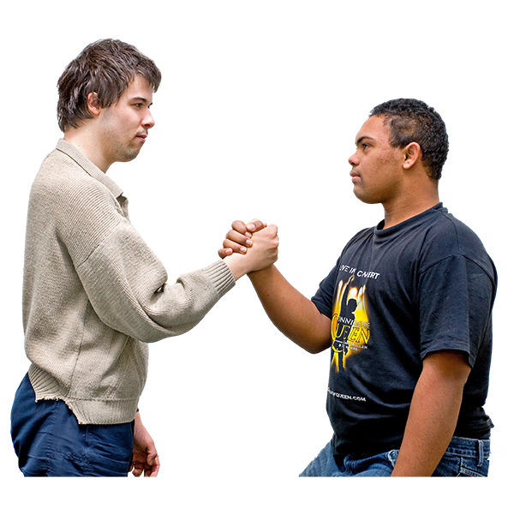
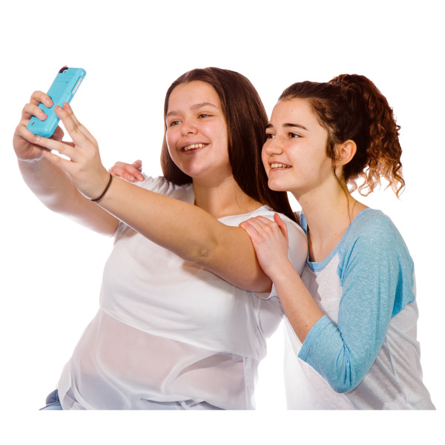

What is a friend?
Notes:
What is friendship?
What does friendship look like to you?
Where are some places that you can make new friends?
How do you make new friends?
Use a whiteboard to write down some ideas.
You can write or draw this in your workbook

Slide 10

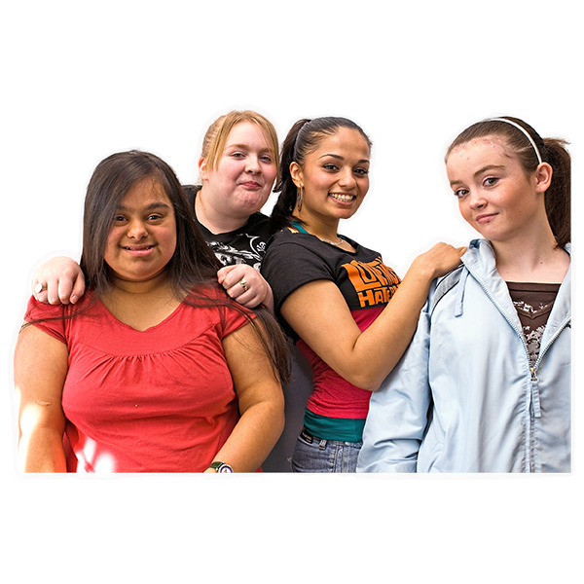
A friend is someone who...
Likes to spend time with you and
you like to spend time with
Likes doing some things the same as you
Is not paid to spend time with you
Chooses to be with you when they don't have to
Is someone you can be YOU with
Notes:
We are now going to watch a video that will talk about how we need to work hard not only to make friends but to make sure we can stay friends.
KEY MESSAGE: Friendships are hard.
And if you do not know much about friendships that is totally fine! That is why we are here today and over the next few weeks to make you an expert on the topic and give you some tips.
We are now going to watch a video that is called ‘Making and Keeping Friends can be Hard’. After we have finished watching the video we are going to look at some things that make it hard to make friends and ways that you can keep a friendship.

Slide 11

What makes a good friend?
Notes:
It is important that your friends
Listen to you
Understand you
Care for you
And much more…
Q1: What makes someone a good friend to you?
- Someone who cares, is kind, listens to me, knows what my interests are and asks about personal things going on in my life, tells me about themselves and their interests, wants to meet up regularly
Let’s have a look at some qualities on the next slide that makes someone a good friend.
Q3: How can you stay good friends if something goes wrong between you?
- Give each other time and space to cool off, take deep breaths to calm down (box breathing), accept your role in the argument, try to see the argument from the other persons eyes, remember the positives about your friendship, plan your apology, make up within a few days of the argument, wait until you are ready before you apologise, plan time to talk to your friend

Slide 12
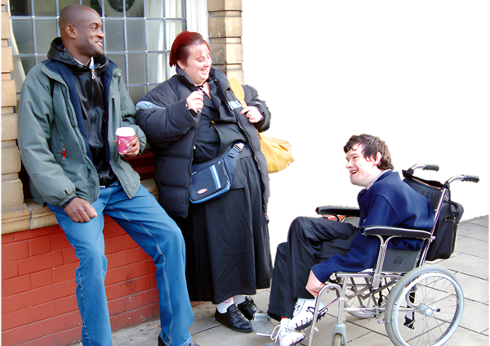
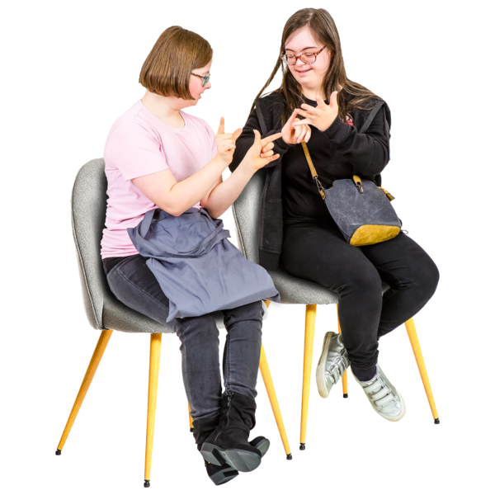
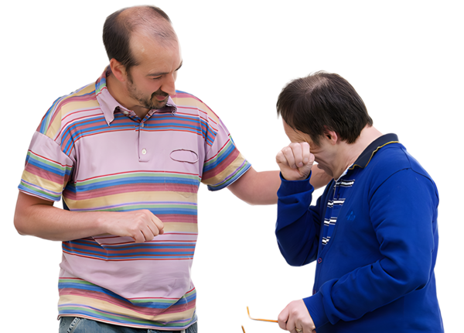
What makes a good friend?
Good friends laugh together
Good friends help each other
Good friends support you when things are good or bad

Slide 13
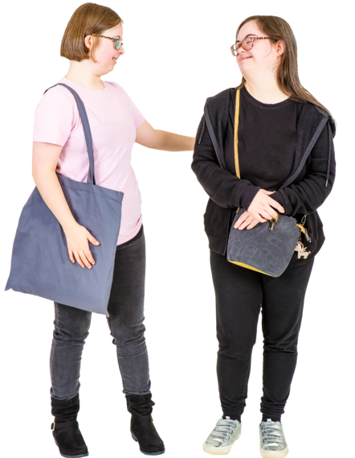
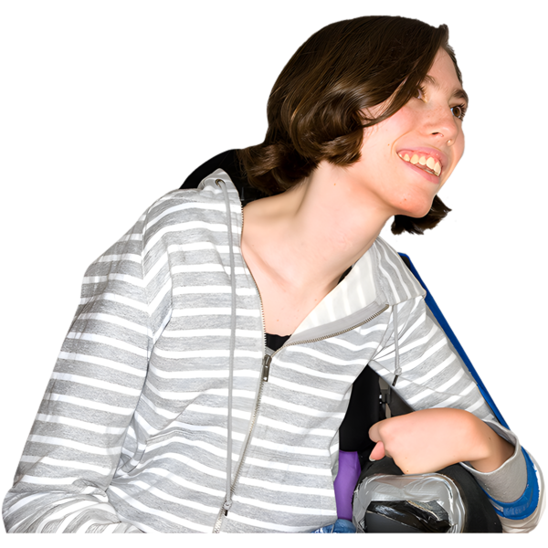
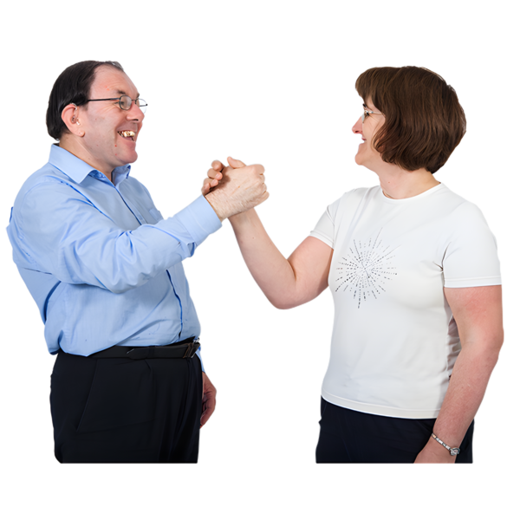
What makes a good friend?
A good friend listens to you
A good friend tries to understand you
Good friends trust each other

Slide 14
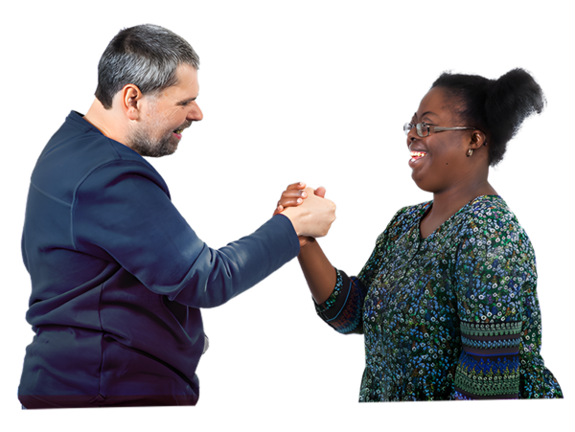
What is trust?

Slide 15
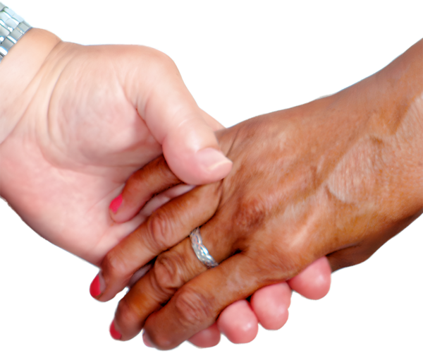
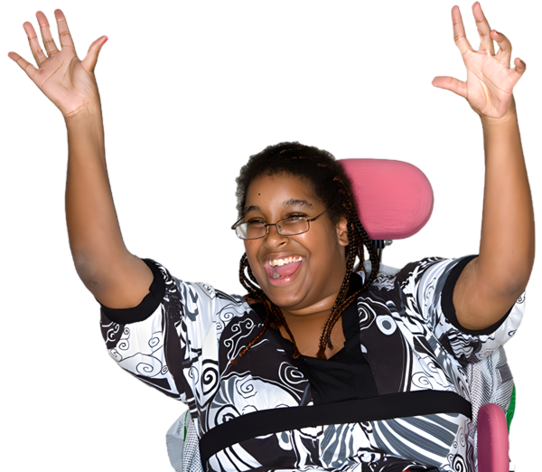

Trust
Trust is having someone who you know will be there for you
Trust is having someone who believes in you
When you trust someone, you know the other person will do what they say they are going to do

Slide 16
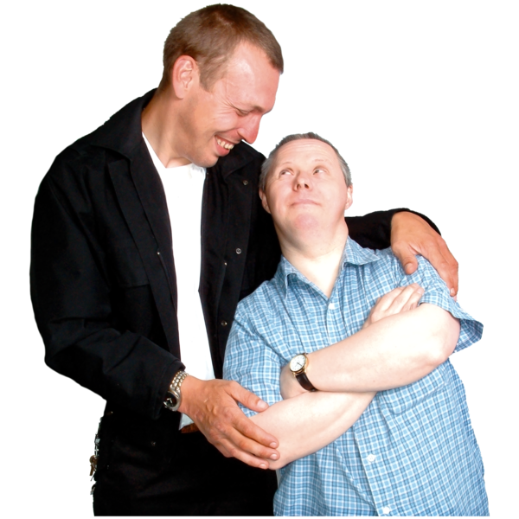
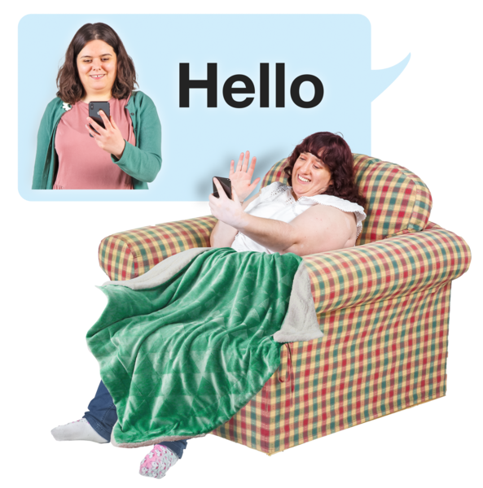
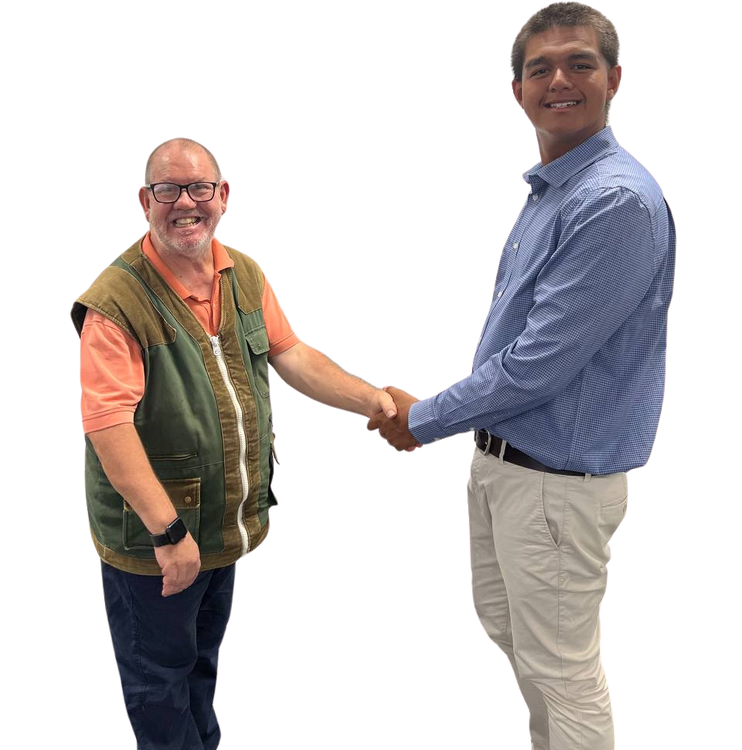
What makes a good friend?
A good friend cares about you
A good friend respects you
A good friend wants to keep in contact with you

Slide 17

How can we keep in contact with our school friends?
Do you have your friends names in your device?
Do your parents have contact numbers for your friends parents?
Do you connect with your friends from school outside school now?
What do you do?
How do you connect? ​
Notes:
Q1: Leaving school/not seeing the person regularly anymore. Been anxious/scared to speak to new people. Not being exposed to opportunities to meet new people. Living far away from each other. Not having access to a mobile phone/social media to stay in contact.

Slide 18
My Friends From School
Name | Parent/Carer's name | Contact number | Things we both enjoy
Notes:
Q1: Leaving school/not seeing the person regularly anymore. Been anxious/scared to speak to new people. Not being exposed to opportunities to meet new people. Living far away from each other. Not having access to a mobile phone/social media to stay in contact.

Slide 19
Family | Family friends
School friends | Footy friends | DADAA friends
School people | Bowling friends | Music Rocks friends
Support team | Circus friends
Work people | Swimming friends
Organising friends in your AAC system
Notes:
Q1: Leaving school/not seeing the person regularly anymore. Been anxious/scared to speak to new people. Not being exposed to opportunities to meet new people. Living far away from each other. Not having access to a mobile phone/social media to stay in contact.

Slide 20
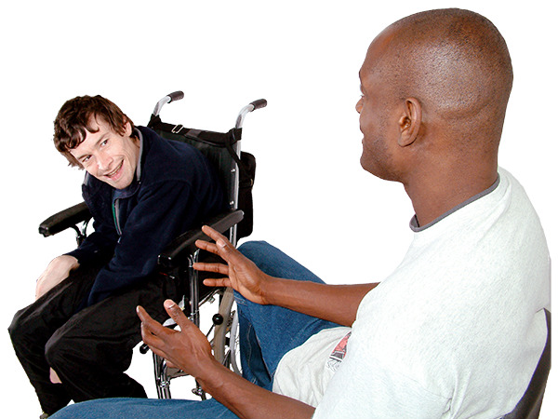
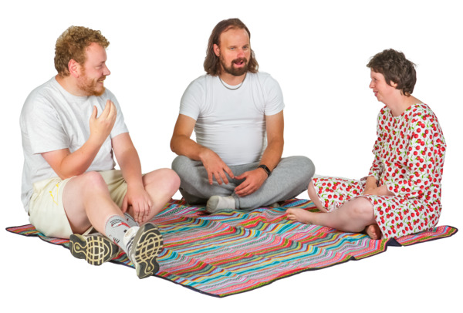
What does connected mean?
Feeling close to other people
Having friends who know us, see us, hear us
Knowing there are people who like to be with us
And we like to be with
Feeling like we belong
Seeing our friends, staying in touch, catching up
Notes:
When we spend time with our friends or new people that we meet
A social connections in our friendships,

Slide 21

It is hard to leave school and not see your friends everyday
Notes:
Q1: Leaving school/not seeing the person regularly anymore. Been anxious/scared to speak to new people. Not being exposed to opportunities to meet new people. Living far away from each other. Not having access to a mobile phone/social media to stay in contact.

Slide 22
How can we keep our school friends?
How can we keep in contact
How can we keep connected
Notes:
Q1: Leaving school/not seeing the person regularly anymore. Been anxious/scared to speak to new people. Not being exposed to opportunities to meet new people. Living far away from each other. Not having access to a mobile phone/social media to stay in contact.

Slide 23
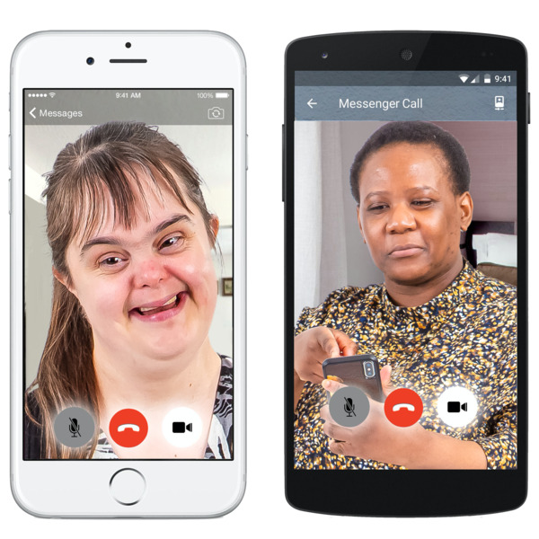
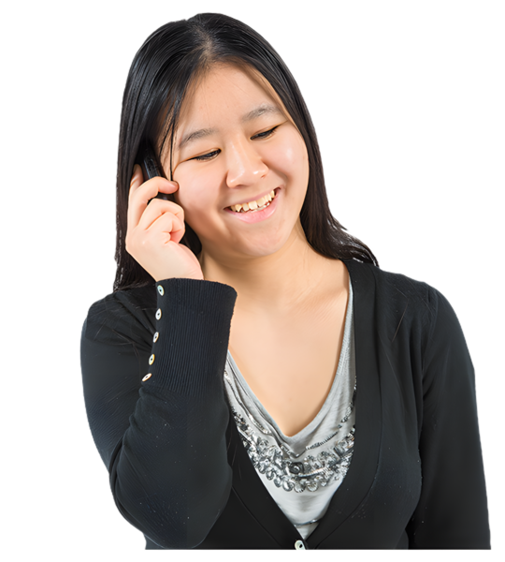
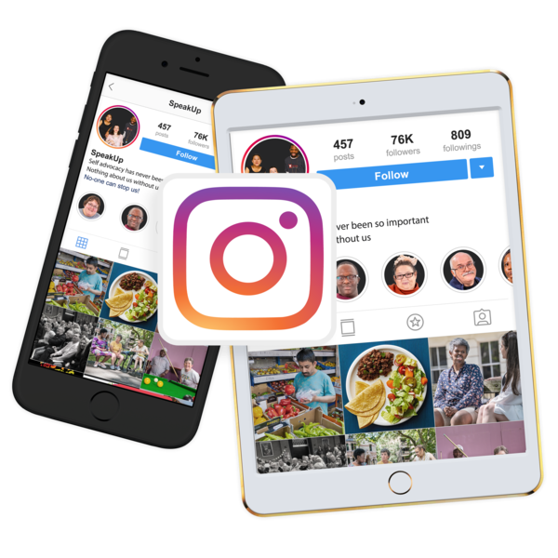
Keep in contact over the phone or in person
Message each other
Facetime
Social media
Notes:
A friendship is like a plant, it needs to be nourished and looked after. When you have a plant you need to give it water, fertilizer, good soil and sunlight to help the plant grow big and strong. Our friendships are the same, they need us to put in work to help them grow.
Q2: Meet up regularly. Keep in contact over the phone or in person. Send regular messages to check in and see how they are going.

Slide 24
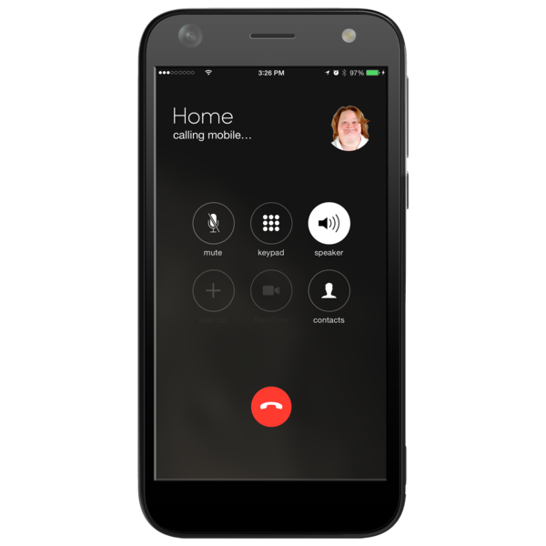

Staying connected with friends from school
There are lots of ways to stay in contact with our friends.
Have you got a way to say:
"I want to stay friends after school, can we share our contacts?
Notes:
CHANGE TO Have you got a way to ask your friends how to stay in contact after school “I want to stay friends after school, can we share our contacts” Are your friends in the AAC device. Template letter to the school (how to help students stay connected after school)
Phone number
Email
Text
WhatsApp
Facetime
Messenger
Facebook
Instagram
Tiktok
Snap Chat
List of icons in front of students

Slide 25
My Friends Contacts
Name | TikTok | Facebook | Instagram | SnapChat | Messages | Facetime | WhatsApp | Zoom
Notes:
Q1: Leaving school/not seeing the person regularly anymore. Been anxious/scared to speak to new people. Not being exposed to opportunities to meet new people. Living far away from each other. Not having access to a mobile phone/social media to stay in contact.

Slide 26
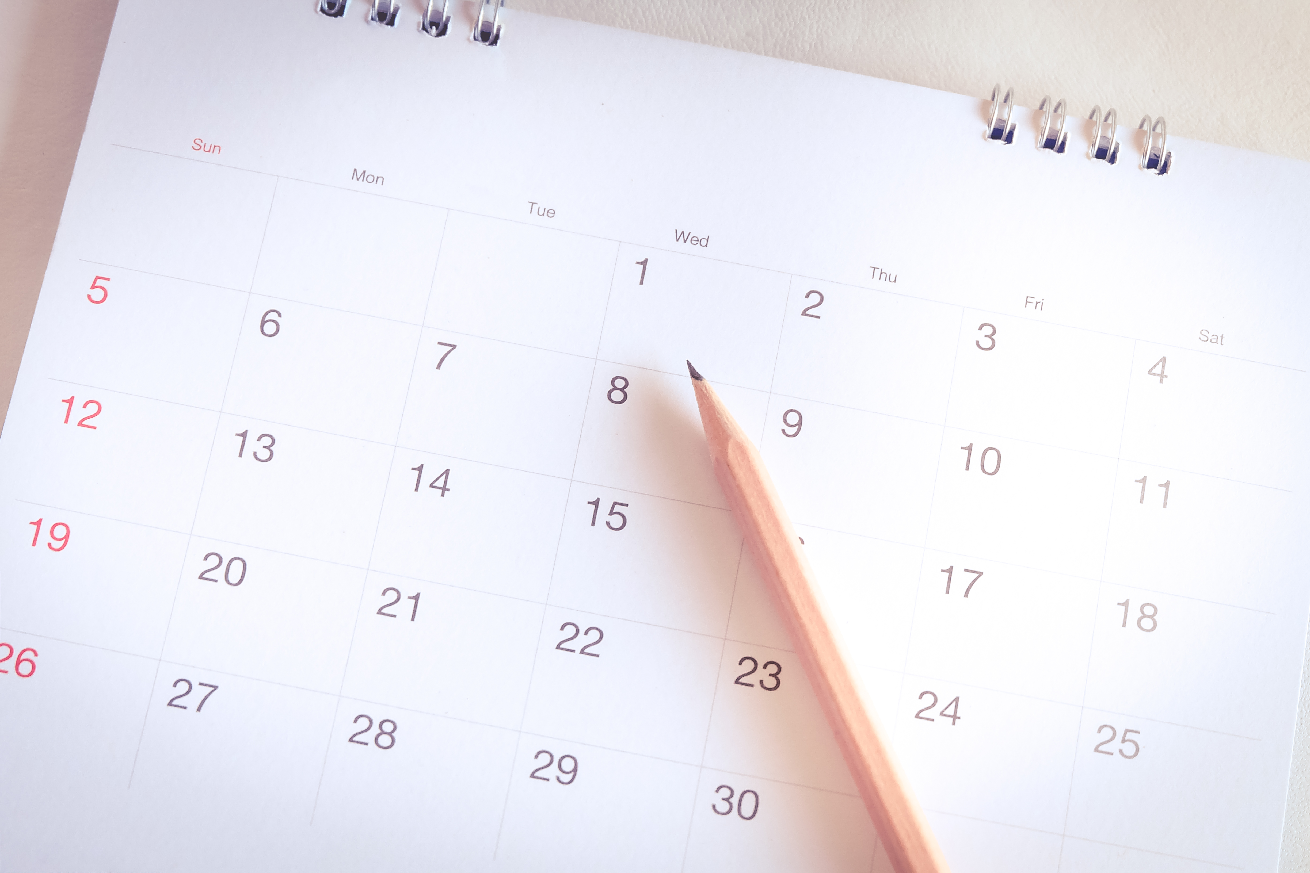
It takes planning to stay connected after school
Notes:
Q1: Leaving school/not seeing the person regularly anymore. Been anxious/scared to speak to new people. Not being exposed to opportunities to meet new people. Living far away from each other. Not having access to a mobile phone/social media to stay in contact.

Slide 27

And planning takes time...
Notes:
Q1: Leaving school/not seeing the person regularly anymore. Been anxious/scared to speak to new people. Not being exposed to opportunities to meet new people. Living far away from each other. Not having access to a mobile phone/social media to stay in contact.

Slide 28
Schedule time to plan connections.
And make a plan to schedule those connections.
Notes:
Q1: Leaving school/not seeing the person regularly anymore. Been anxious/scared to speak to new people. Not being exposed to opportunities to meet new people. Living far away from each other. Not having access to a mobile phone/social media to stay in contact.

Slide 29

Plan for:
Who do you want to connect with?
How do you want to connect?
What do you want to do?
How soon?
Put it in your schedule.
Notes:
Q1: Leaving school/not seeing the person regularly anymore. Been anxious/scared to speak to new people. Not being exposed to opportunities to meet new people. Living far away from each other. Not having access to a mobile phone/social media to stay in contact.

Slide 30
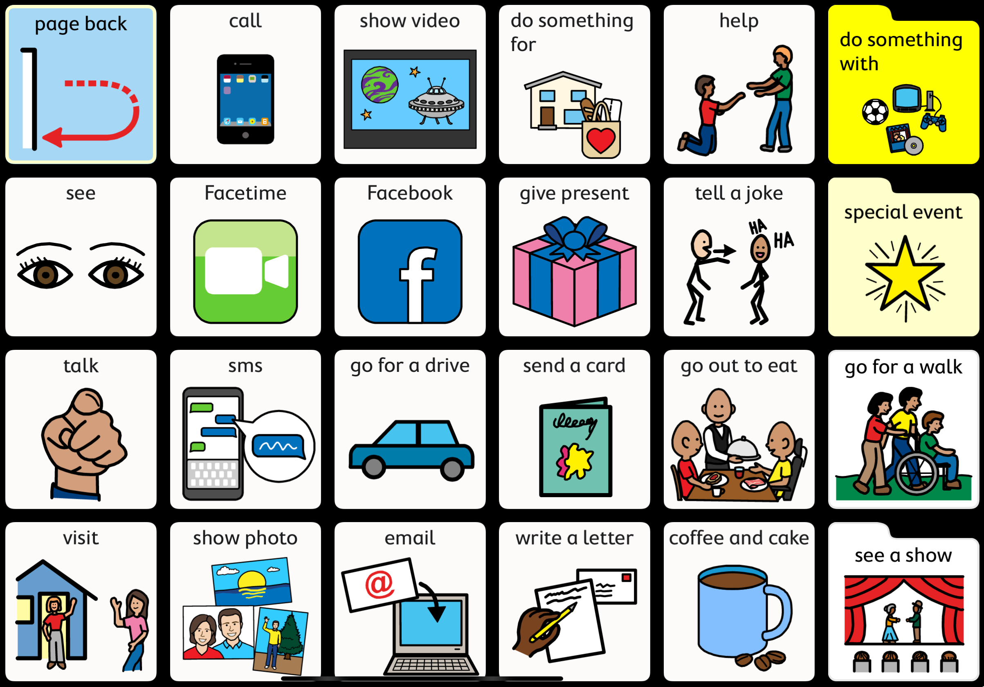
Example language for planning ways to catch up
Notes:
Things we can do...

Slide 31
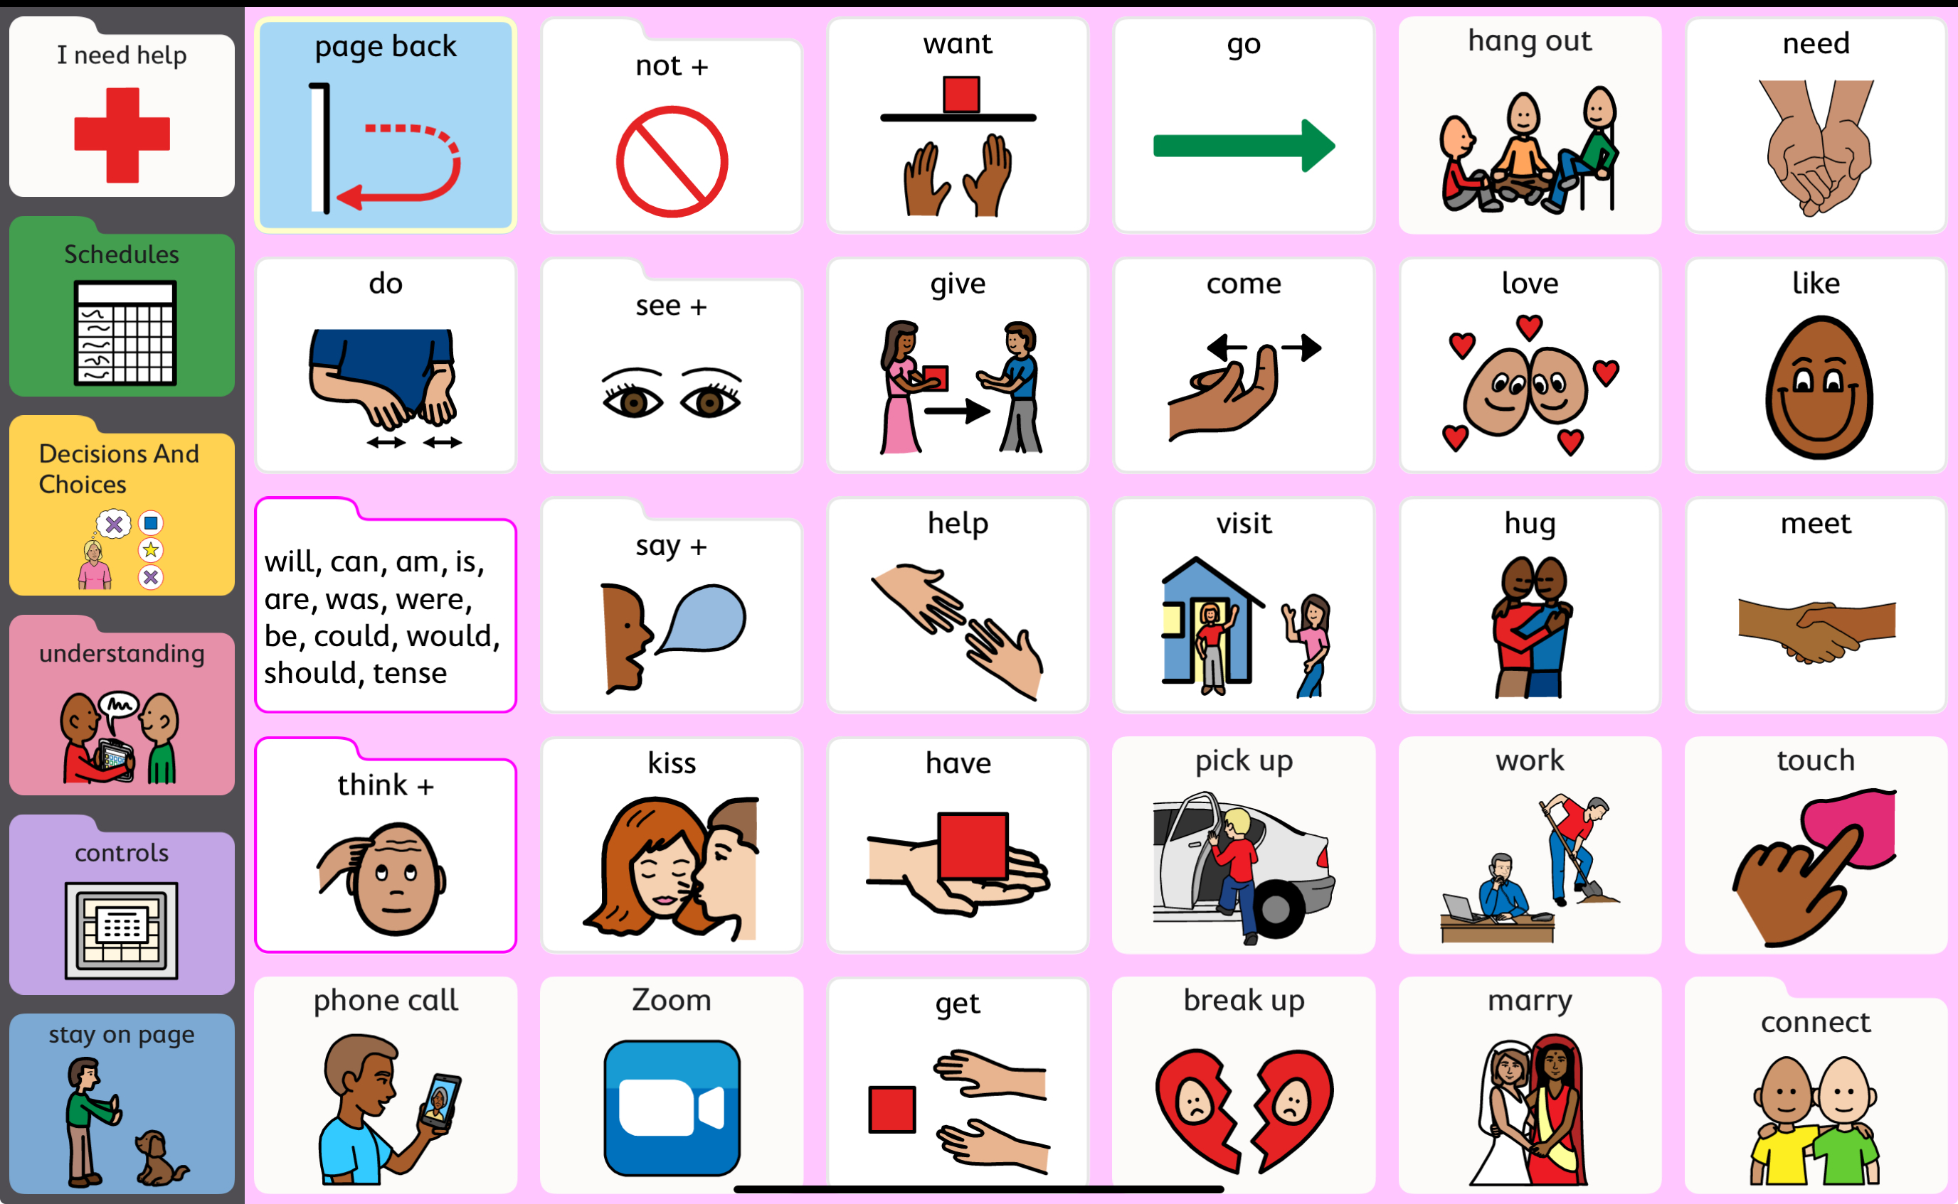
Friendship through AAC:
Example actions language needed
Notes:
Q1: Leaving school/not seeing the person regularly anymore. Been anxious/scared to speak to new people. Not being exposed to opportunities to meet new people. Living far away from each other. Not having access to a mobile phone/social media to stay in contact.

Slide 32
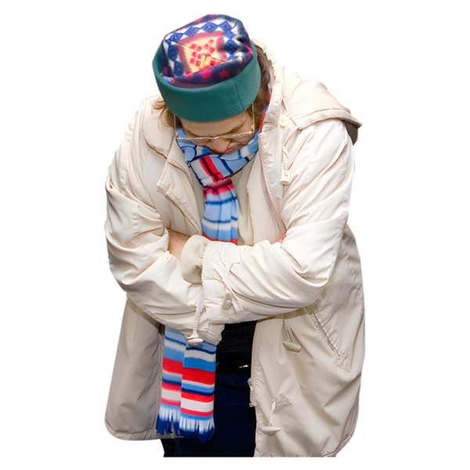
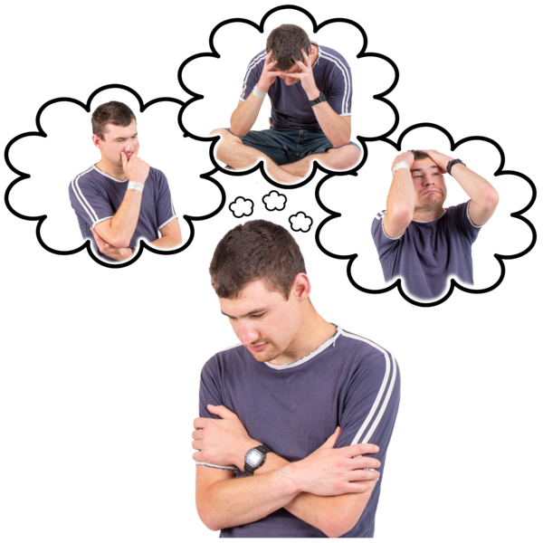
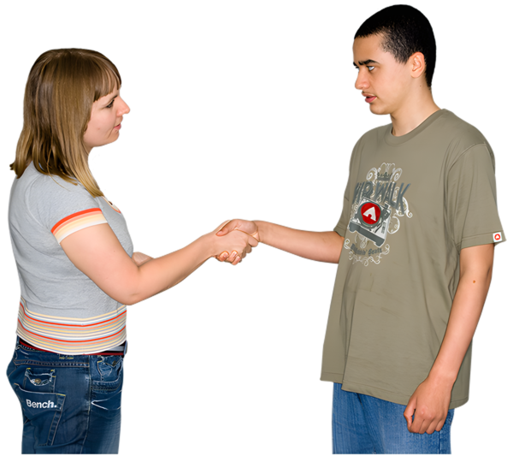
Meeting new people when we leave school
Meeting new people can be scary
You might feel nervous
But meeting new people is the first step to making new friends.
Notes:
WHY MIGHT YOU BE NERVOUS TO MEET NEW PEOPLE?
WHAT ARE SOME WAYS THAT YOU CAN CALM YOUR NERVES?
Where are some places that we can meet new people?

Slide 33
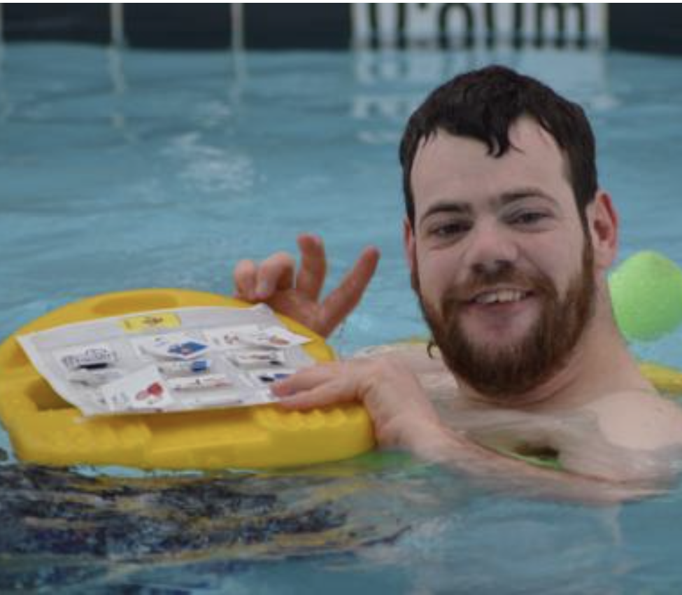
Where can we meet new people
Try going to places to do the things you like
Other people there might like doing the same thing
Having things you like in common can be a good way to meet new people
Try going to the same place lots and lot and lots of times
This can help you and the other person feel ready to say hi for the first time.
ddwa.org.au
Notes:
We need to have a way to tell the other person how we communicate
? Talk about a communication profile
Then we can help them understand us

Slide 34
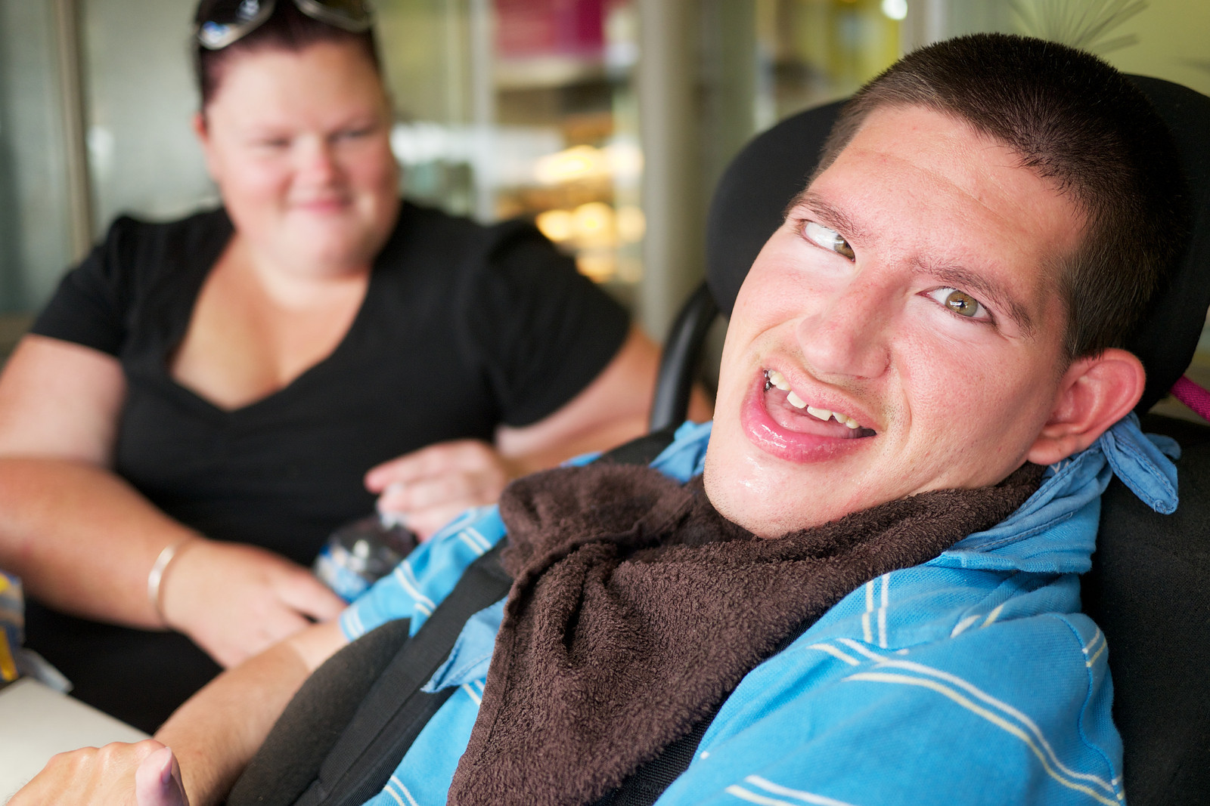
Meeting new people
When we meet someone new, we need a way to get their attention
We might look at them, smile and call out with our voice
We might wave and smile at them
We might use a switch to say "Hi! Hey! How you going?"
You might give them a contact card or communication card to tell them how we can best chat together
ddwa.org.au

Slide 35
Hi there! My name is...
I would love to chat to you! I don't use mouth words to talk. I use.... by.... The best way to chat with me is if you....

Slide 36
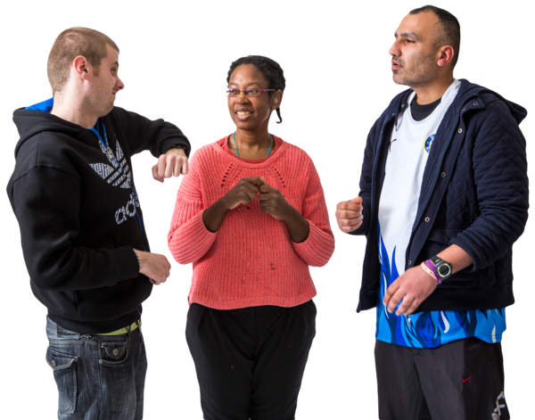

Getting to know new people
After you have met them, you might want to find out if you have something in common
Having something in common or shared interests is a good start for a friendship
You might find the same things funny
You might like the same music
You might both love walking your dogs
Notes:
It takes lots and lots and lots of times meeting someone again, and again, and again to get to know them enough to make friends.

Slide 37
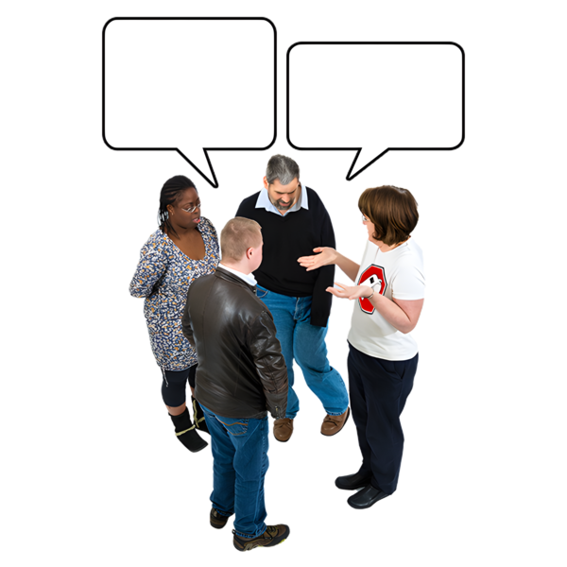
Getting to know new people
In the next few slides, we are going to look at some ideas for conversation starters
Favourite conversation starters can make good pre-stored phrases in a "Quick chat" folder

Slide 38
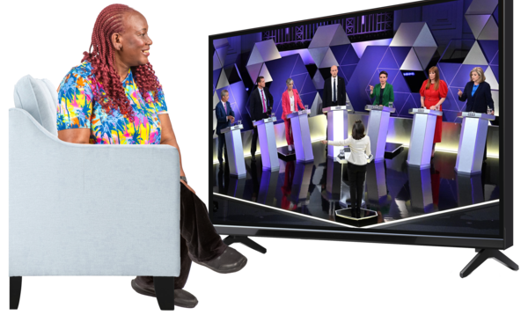

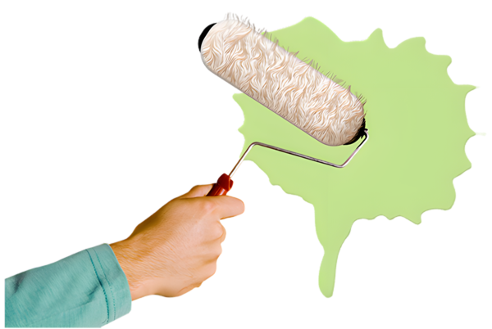
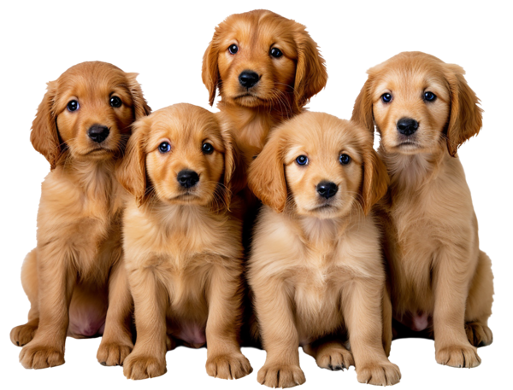
Conversation starters
What is your favourite movie or tv show?
What foods do you like?
What do you like to do on the weekend?
What would be your dream pet?
Notes:
Role play using the conversation starters

Slide 39




Conversation starters
Do you like to stay up late?
Do you like to get up early?
If you could have one superpower, what would it be?
What things don’t you like to do?
Notes:
Role play using the conversation starters
Make up an aided language display of conversation starters

Slide 40
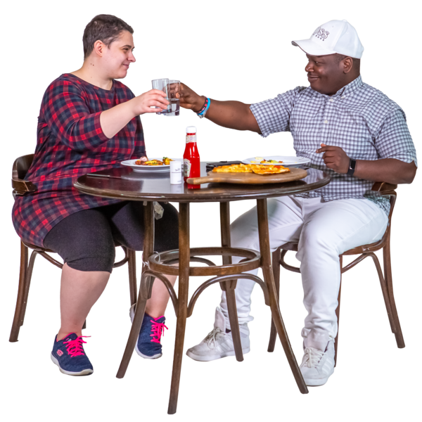

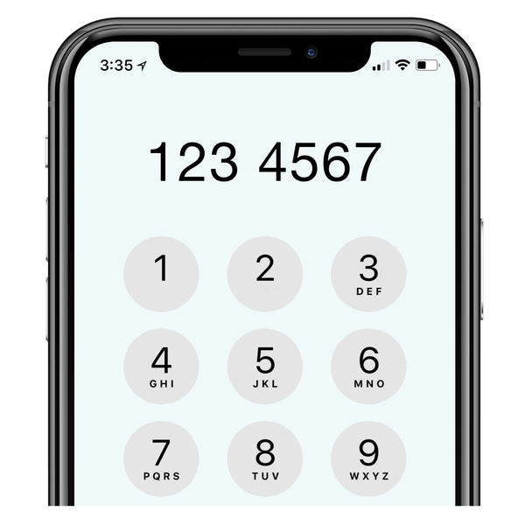
Friendship
It takes a long time to make a friendship.
After a while you might want to exchange contact details.
Or you might just want to meet up at the same place again.

Slide 41
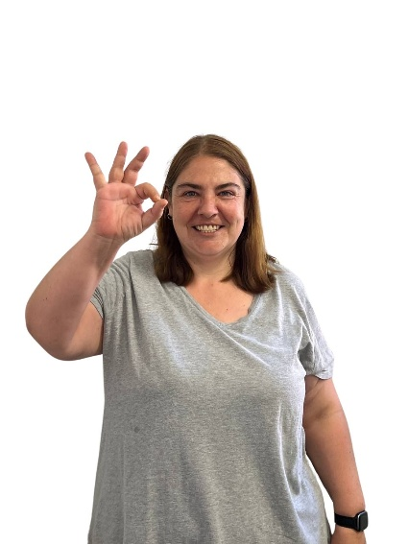
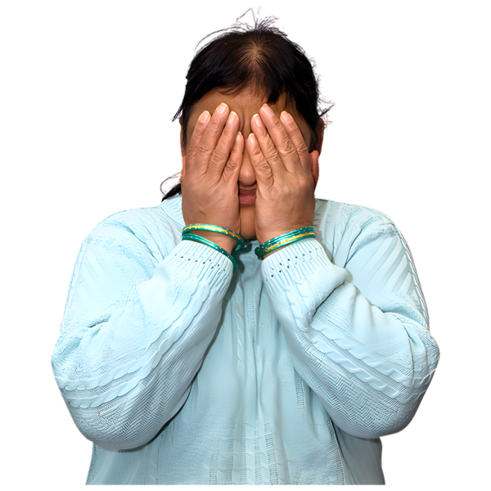
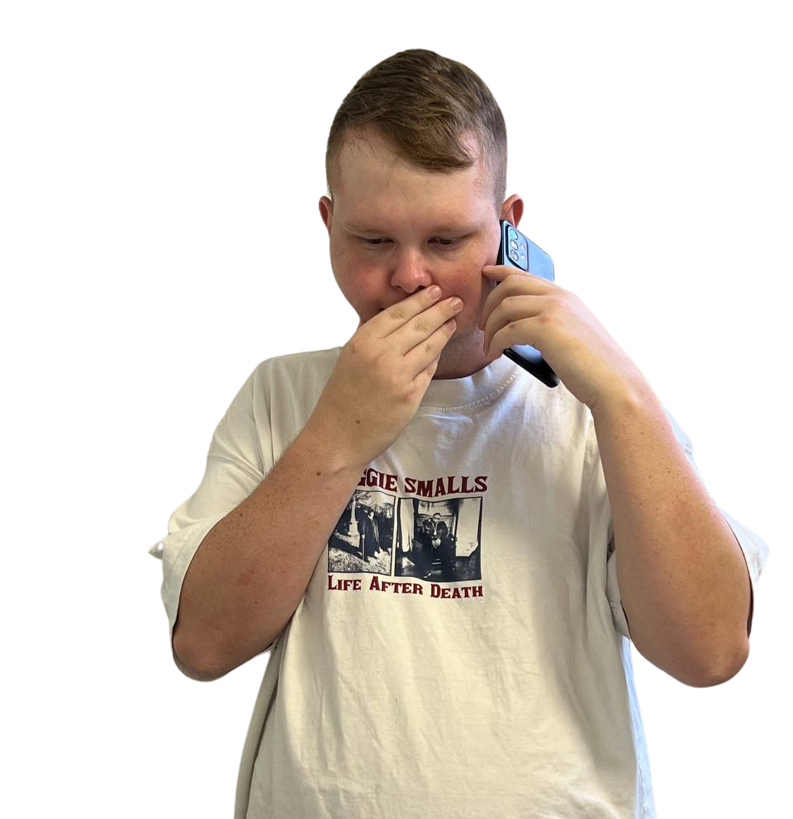
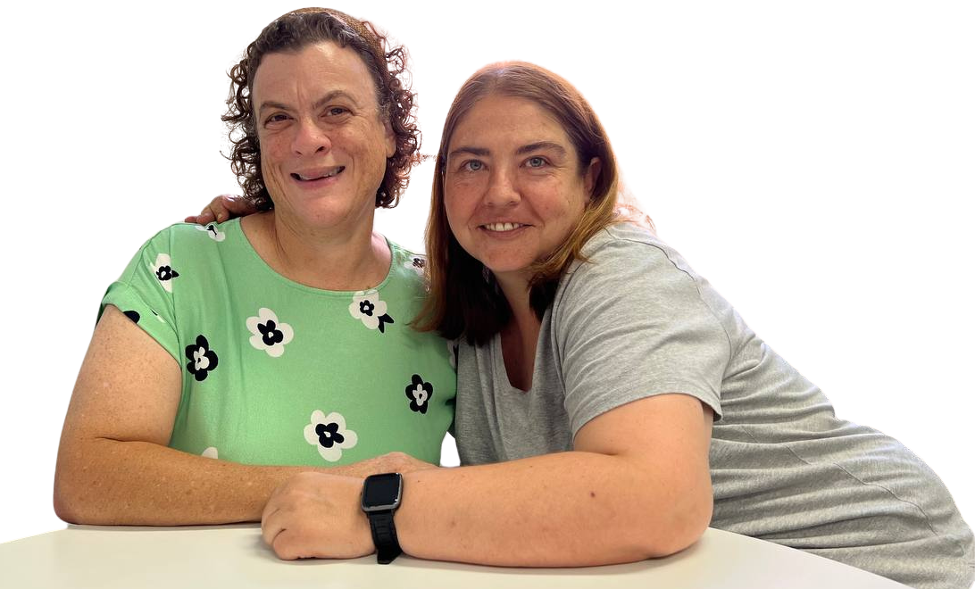
Nobody is perfect!
When making friends we don’t have to be perfect.
We might feel shy or embarrassed and that is ok.
Sometimes it is be difficult to say what we want to.
Tell yourself that you’re doing a good job and that you’re learning something new.

Slide 42
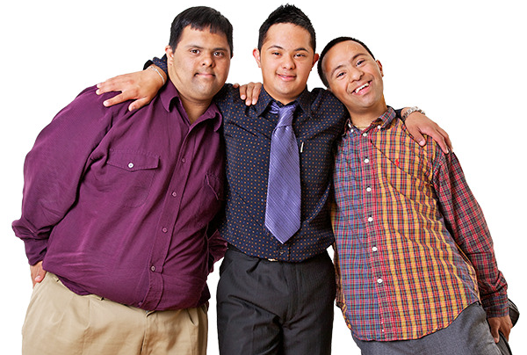



What have we learnt today?
Friends are important
Keeping in contact with our school friends takes planning.
We might need help to have the words we need to plan.
We might need help to make the time to plan.
We might need help to turn our plan into a real catch up.
There are lots of ways we can stay connected but the planning needs to start now
Meeting new people is the first step to making new friends.
Try meeting people doing things you enjoy.
Do not be scared to say hi and get to know someone new.

Slide 43

Thank you!

