Slide 1

DDWA Self Advocacy Program
Session 3. How to Self Advocate
ddwa.org.au

Slide 2
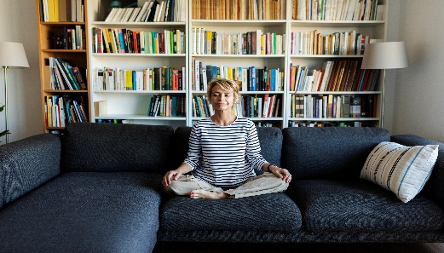
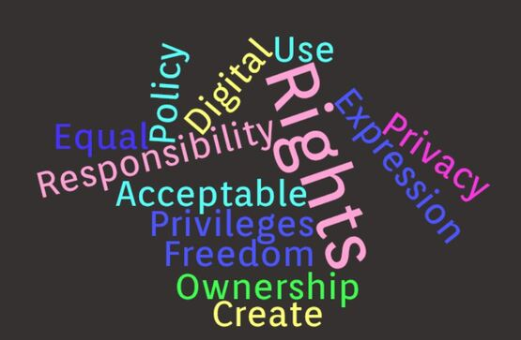
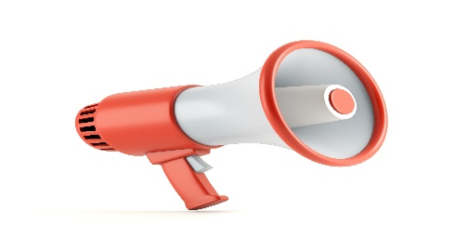

Tools we need for Self Advocacy
Step 1: Get to know yourself
Step 2: Learn your rights and
responsibilities
Step 3: Speak Up!
Step 4: Team Up!
ddwa.org.au
Notes:
Lets go through each one and think about how they can help me know when I need to stand up for myself

Slide 3
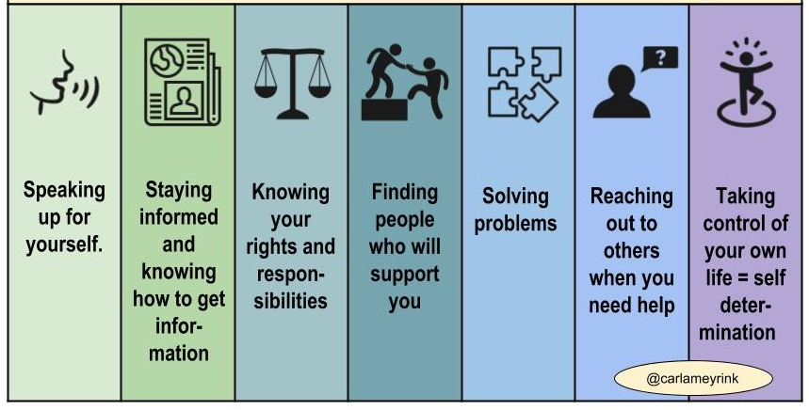
What is Self Advocacy?
ddwa.org.au

Slide 4
How can I Self Advocate?
Self Expression -I express my feelings and assert my opinions
Self determination-I make decisions for myself and make plans for my own life
Self Confidence-I take responsibility for asserting my own rights and the rights of others
Self reliance-I do things for myself whenever I can
Self development-I have goals and dreams and I am going to achieve them
Self Esteem- I feel good about myself and believe I can make a difference
ddwa.org.au

Slide 5
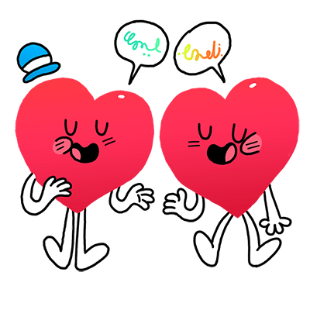

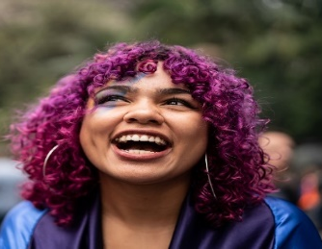
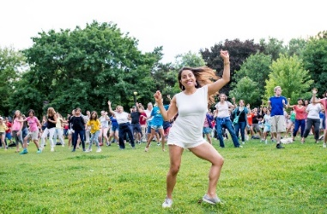
Self Expression
I express my feelings.
I let others know my opinions.
Can be through words, clothing and hairstyle, writing, drawing, music and dance.
Self expression can help you to show your true self-your story, your thoughts, feelings and emotions.
ddwa.org.au
Notes:
My feelings are important and I can be who I want to be

Slide 6

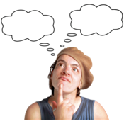

Self Determination
I make decisions for myself.
I make plans for my own life.
I am working to reach my goals.
ddwa.org.au
Notes:
It is my responsibility to make decisions for me

Slide 7

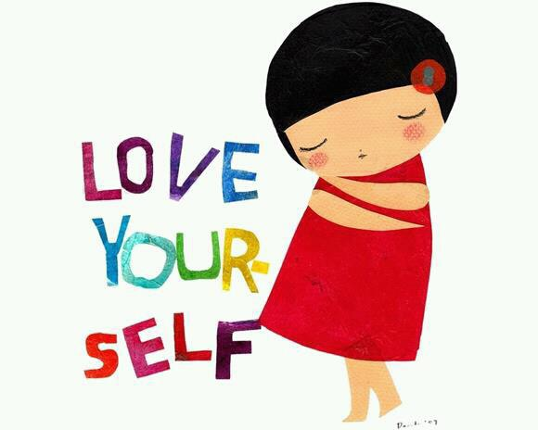

Self Confidence
I have trust in my own ability.
I have belief in my own ability.
I know my good qualities.
I know my worth.
I know my strengths.
I am nice to myself.
I do my best.
ddwa.org.au
Notes:
I have responsibility for standing up for myself when I need to and believing that I can

Slide 8
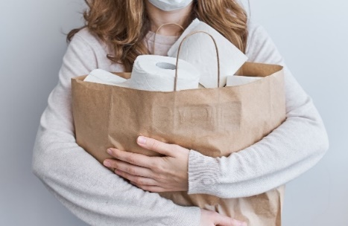

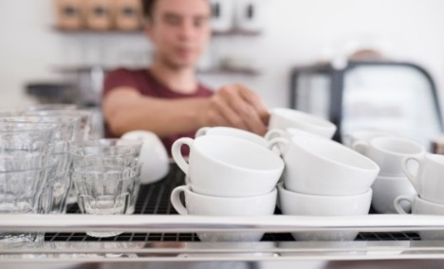
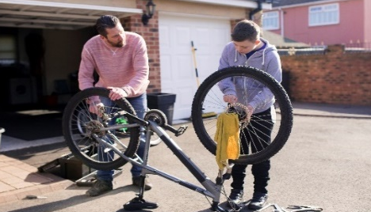
Self Reliance
I think independently.
I can do things for myself whenever I can.
I can manage my time.
I can tidy up after myself.
I can ask for help if I need to.
I can complete what I begin.
ddwa.org.au
Notes:
It is good for me to be independent and makes me feel strong

Slide 9


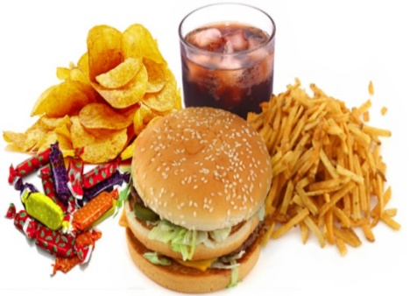
Self Development
I have goals and dreams and I am going to achieve them.
I can learn a new skill.
I can overcome a bad habit.
ddwa.org.au
Notes:
I can improve my life by always having something to aim for and being positive. I can change things I don’t like or know are bad for me.

Slide 10
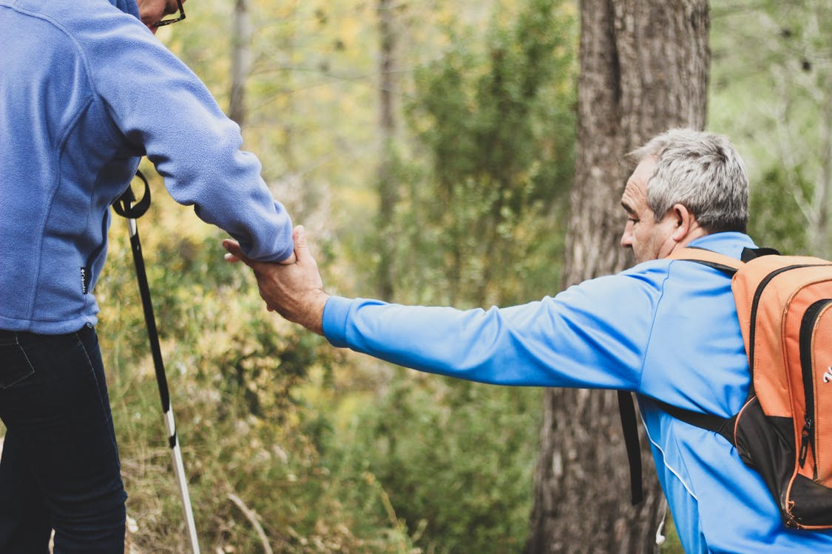


Self Esteem
Remember the things that make you happy.
Count the things you’ve done well at.
Remember your gifts and talents.
ddwa.org.au
Notes:
I feel good about myself and believe I can make a difference.

Slide 11

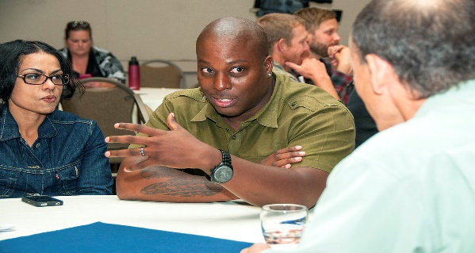

Remember when Speaking up
Recognise my feelings-don’t bottle them up.
Learning to express our feelings and Identify the issue.
Speak up and seek out someone you trust for support.
ddwa.org.au

Slide 12
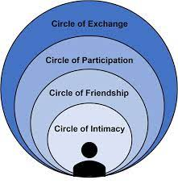
Circles of Support- the closer in, the more they are someone you trust who could support you
Social Media Friends
Community members
Support workers
Your friends
Your family
Carers
ddwa.org.au

Slide 13

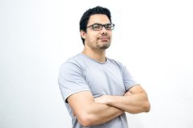
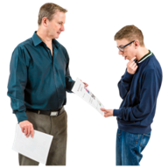


Remember our Self Advocacy Tools
Know your rights.
Feel confident to speak up.
Get help from someone you trust.
Decide what you need and want.
Ask for it
ddwa.org.au

Slide 14
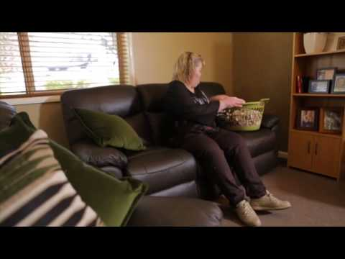
Video: Self Advocacy
ddwa.org.au

Slide 15
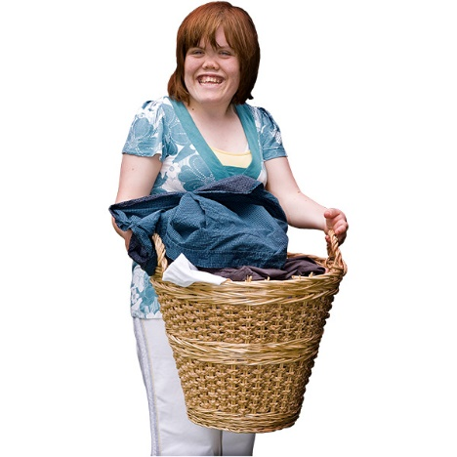
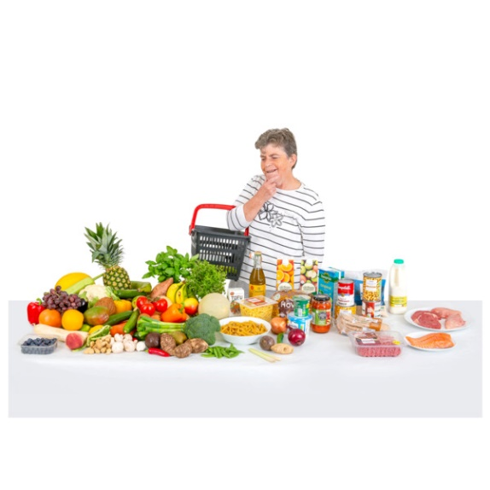
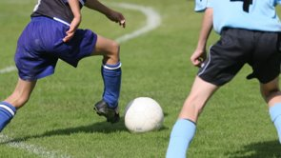
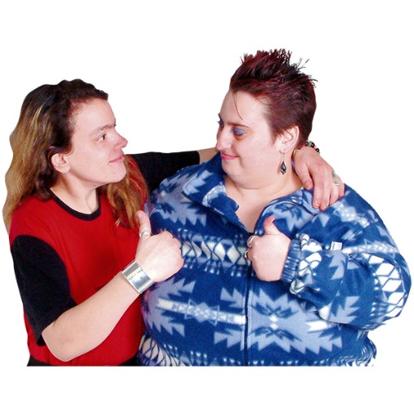

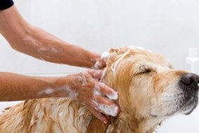
What makes for a good life?
ddwa.org.au
Notes:
Ask group members to think about what makes a good life for them? Could do this on butchers paper or in pairs

Slide 16
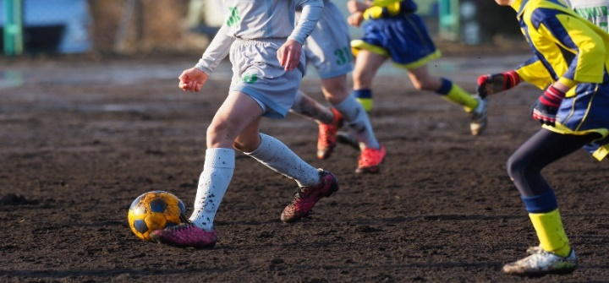
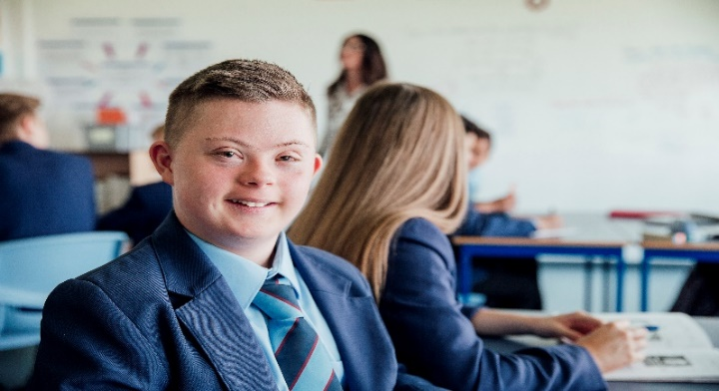
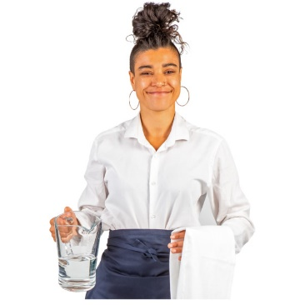
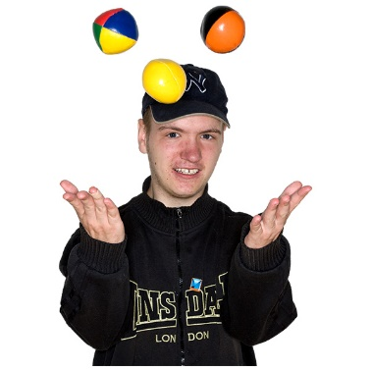
Things that help you have a good life
What do you like to do?
Hobbies and interests
School, work, volunteering
Learning new skills
ddwa.org.au

Slide 17

Friends and Family
Who’s in your circle?
ddwa.org.au
Notes:
Who are your supports?

Slide 18


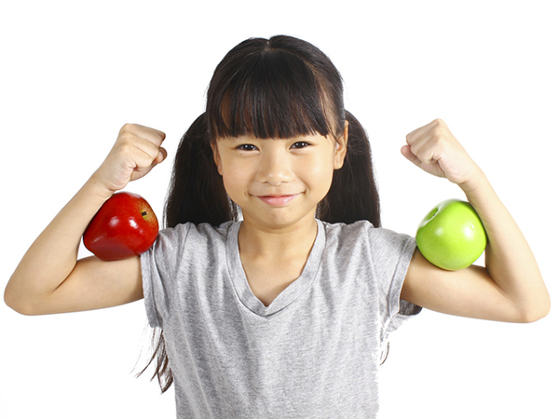
Things that help you have a good life
Self Direction
What choices do you want to have?
Feeling valued
What makes you feel valued?
Health
How do you keep healthy and feeling good?
ddwa.org.au

Slide 19
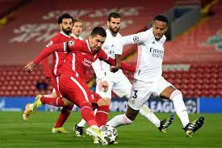
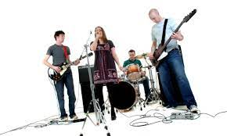

What things are important TO me?
Sports team
Music
Holidays
ddwa.org.au

Slide 20
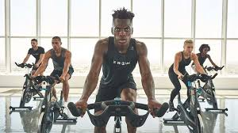
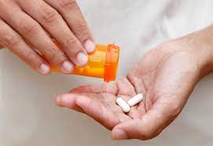
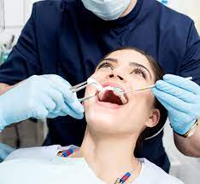
What things are important FOR me?
Exercise to stay healthy.
Take my medicine.
Go to the dentist.
ddwa.org.au

Slide 21
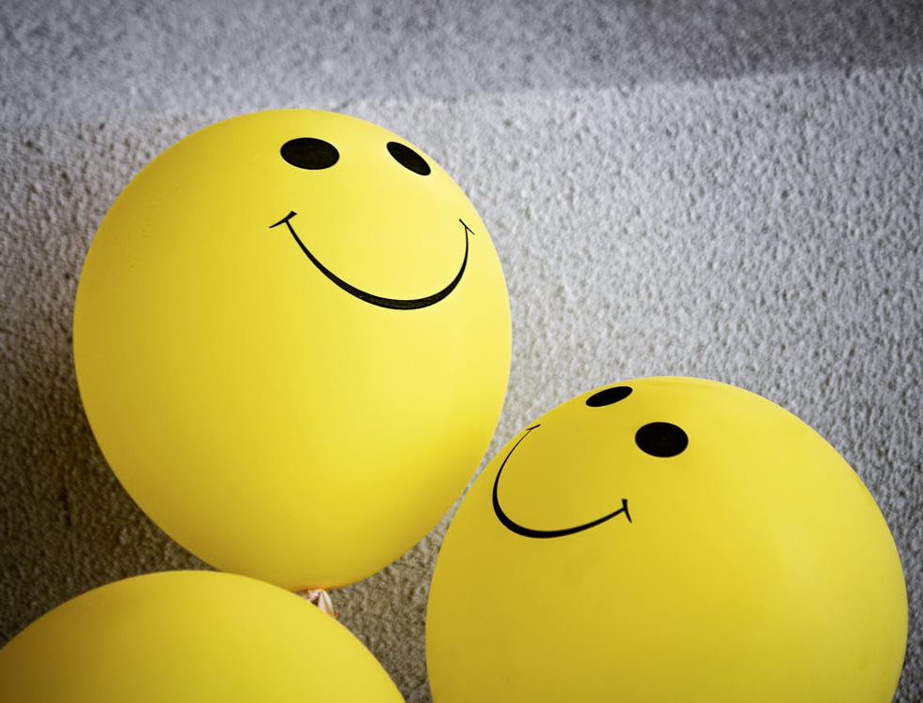
What makes a GOOD day for me?
_______________________________________________________________________________________________________________________________________________________________________________________________________________________________________________________________________________________________________________________________________________________________________________________________________________________________________________________________________________________________________________
ddwa.org.au
Notes:
Things I like

Slide 22

What makes a BAD day for me?
_______________________________________________________________________________________________________________________________________________________________________________________________________________________________________________________________________________________________________________________________________________________________________________________________________________________________________________________________________________________________________________
ddwa.org.au
Notes:
Things I don’t like

Slide 23
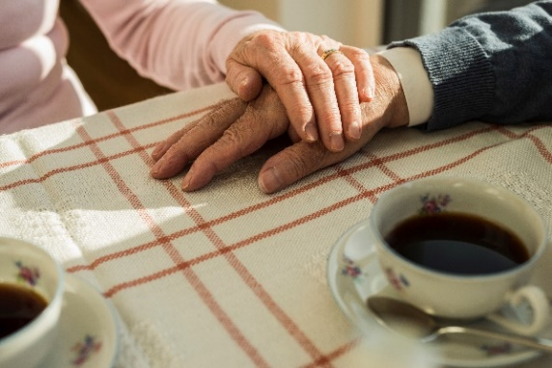
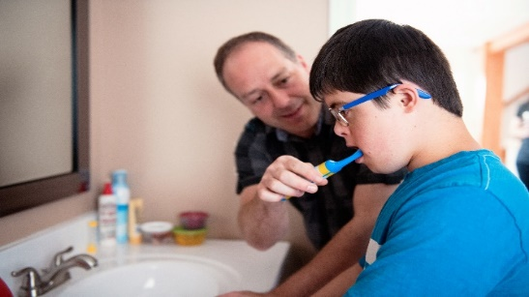
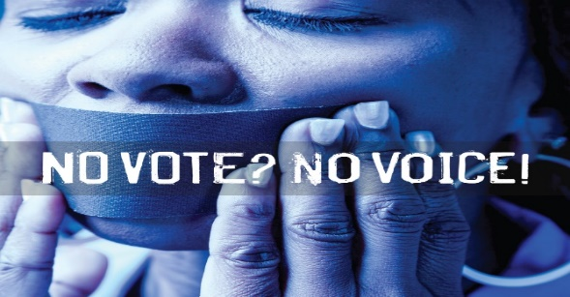
Practice our Self advocacy skills
Someone says, “he takes 2 sugars in his coffee.”
Someone comes into your bedroom without knocking.
Someone keeps doing things for you that you can do yourself.
Someone takes your lunch.
Someone tells you that you can't go out.
Someone says you can’t vote.
ddwa.org.au
Notes:
Ask in the group if anyone has any other examples where they have had to use their self advocacy skills.

Slide 24

REMEMBER
You are the most important person in your life.
Start to practice your self advocacy skills.
​
Start thinking about your dreams, goals and needs. ​
ddwa.org.au

