Slide 1

DDWA Self Advocacy Program
Session 2. Knowing Your Rights
ddwa.org.au

Slide 2
What will we learn in this session?
Human Rights – What are my RIGHTS?
Responsibilities – to respect the rights of others – it's a two-way thing
Feelings and how they link into your rights
What to do if your rights are breached
ddwa.org.au

Slide 3

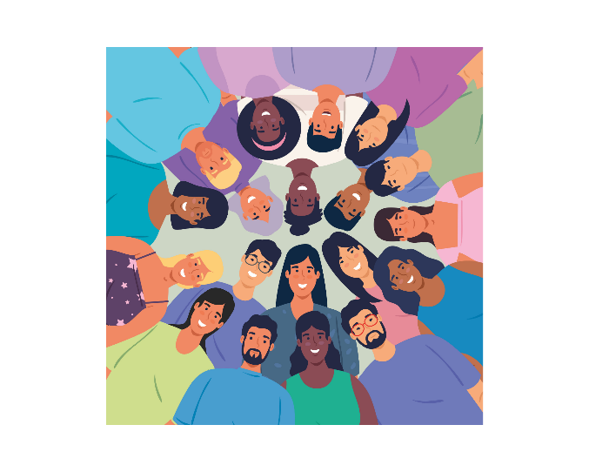
Let’s talk about Human Rights
Every person has RIGHTS
All people have equal rights,
no matter who you are,
or what you do.
ddwa.org.au

Slide 4

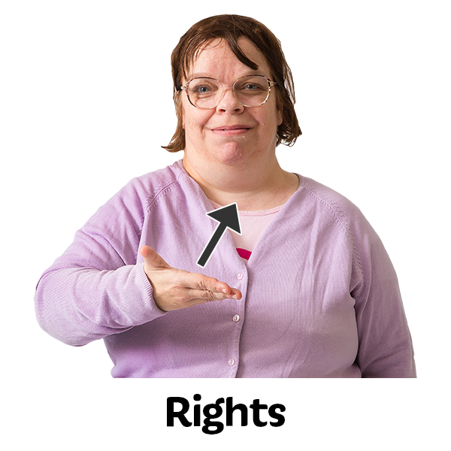
Rights
Rights are things you can:
Be- like you want to be a hairdresser
Do- like you want to go on a holiday
Have- like you want to have your own place to live in
ddwa.org.au

Slide 5

Knowing your Rights can help you Self-Advocate
No one can take away your rights​!
ddwa.org.au

Slide 6
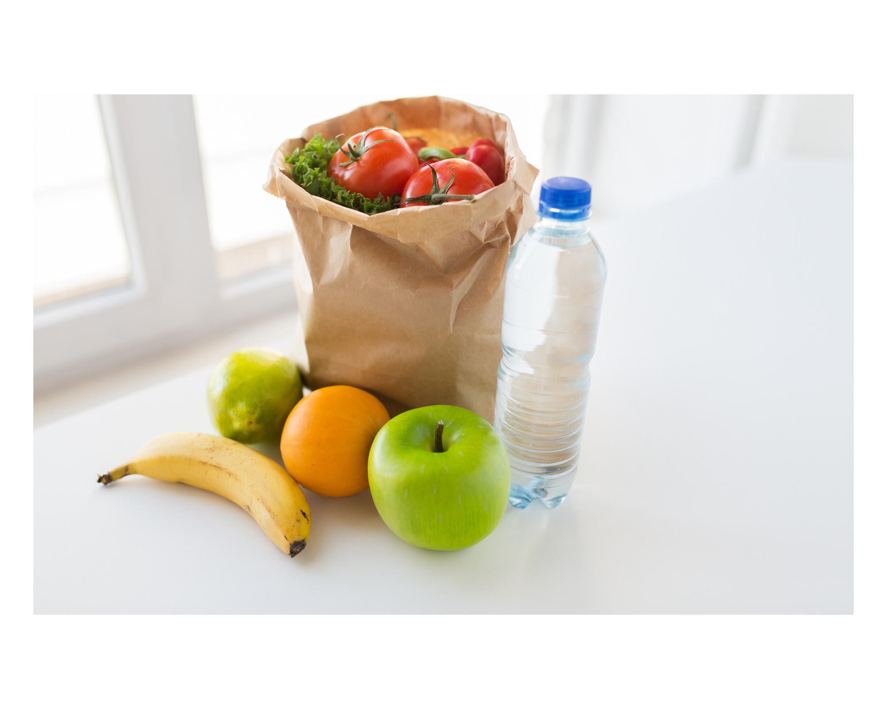
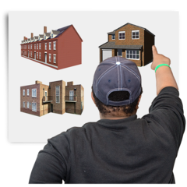
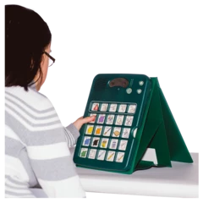
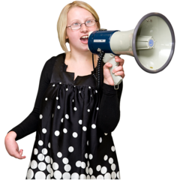
Basic Rights - You have the right to
Food and Water
A safe place to live
The right to communicate your needs and choices
ddwa.org.au

Slide 7

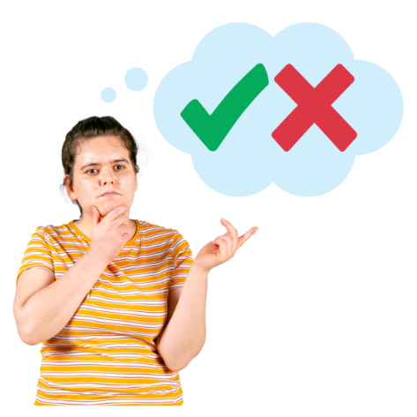
What are Your Rights?
You have the right to;
Individual Freedom
To be treated as a person who is able to make choices and decisions and be in control of your own life.
ddwa.org.au

Slide 8
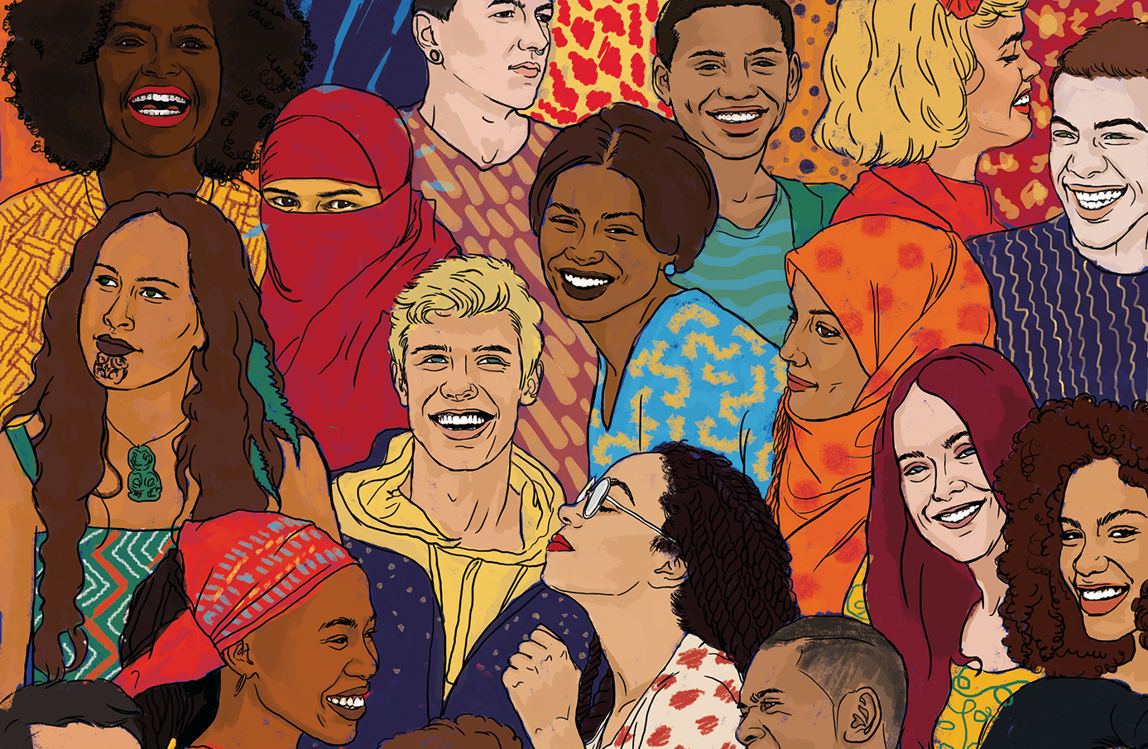
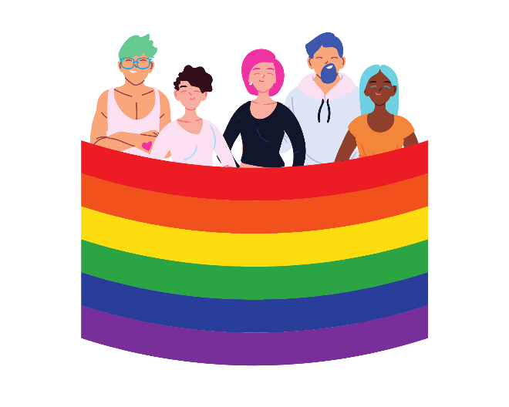
What are Your Rights?
You have the right to;
Respect for difference
To be accepted and valued for your uniqueness and difference.
This means no matter your gender identity, sexuality, background, religion, beliefs, language or culture.
ddwa.org.au

Slide 9
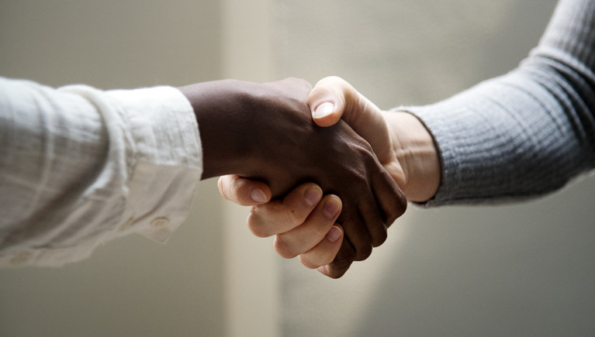
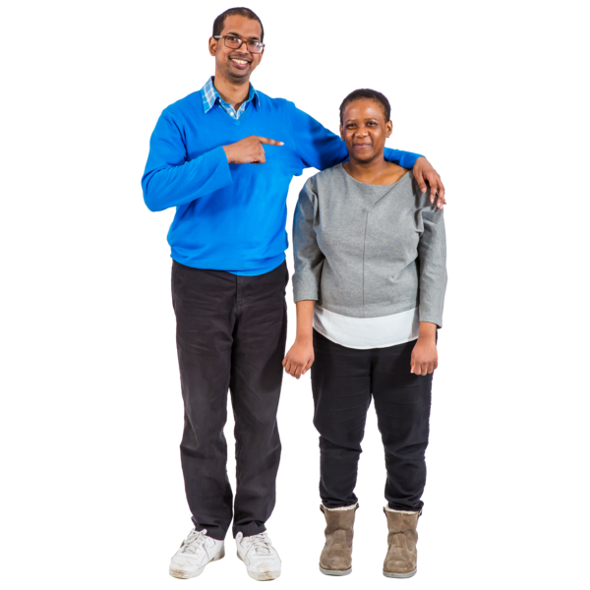
What are Your Rights?
You have the right to;
Respect and Dignity
To be valued for who you are.
To be shown by others that your ideas, wants and needs are important.
ddwa.org.au

Slide 10
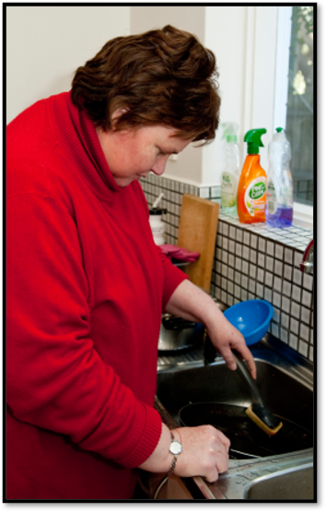
What are Your Rights?
You have the right to;
Independence
To do things for yourself
and be able to choose
the things you do .
(You have the right
to ask for help too!)
ddwa.org.au

Slide 11
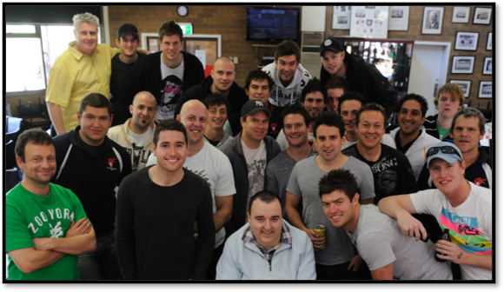

What are Your Rights?
You have the right to;
Be Included
To be included in your community and participate in activities with others.
ddwa.org.au

Slide 12

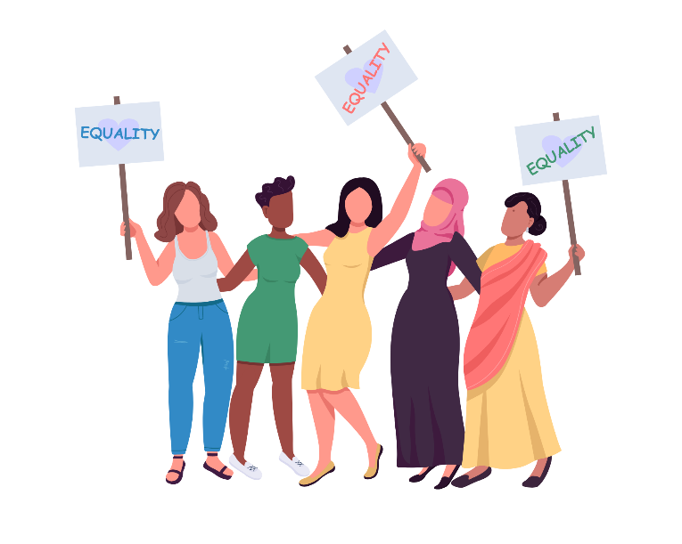
What are Your Rights?
You have the right to;
Live free from Discrimination
No one should be treated differently because of their beliefs, abilities, race, gender, sexuality, background, religion, or language.
ddwa.org.au

Slide 13
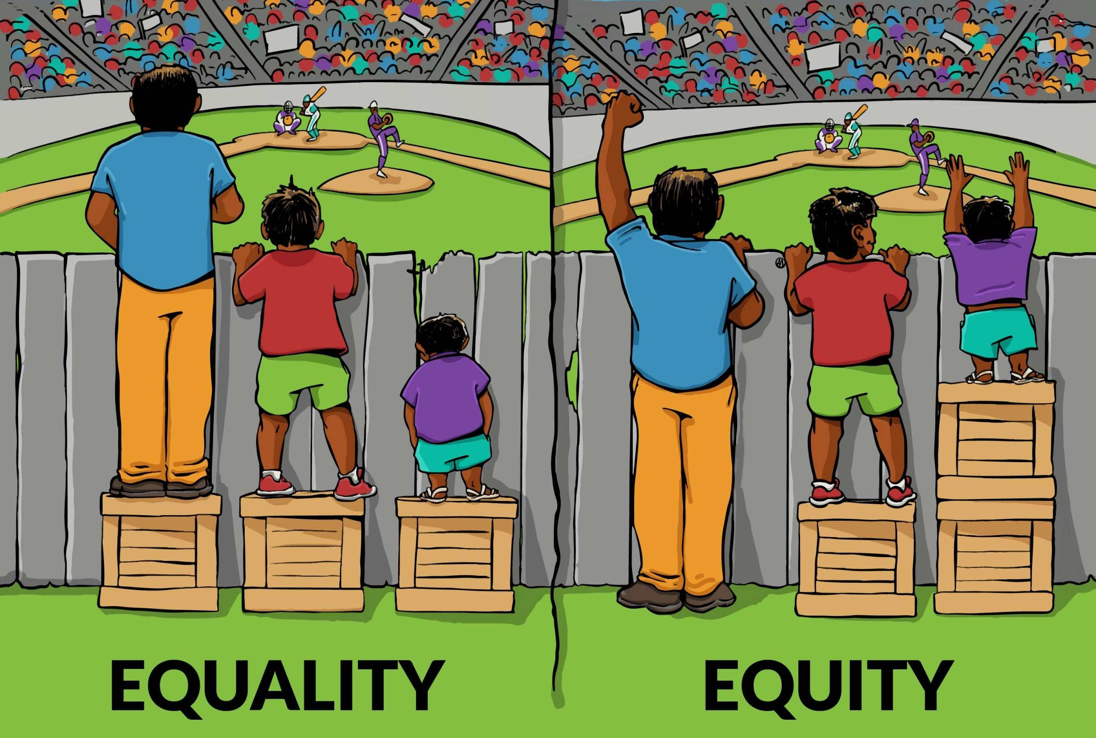

What are Your Rights?
You have the right to;
Equal Opportunity
To have the chance to do the same things as anyone else.
ddwa.org.au

Slide 14
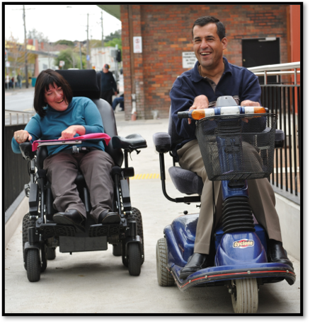
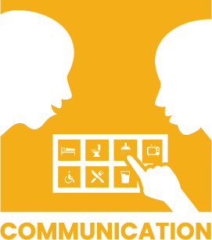
What are Your Rights?
You have the right to;
Accessibility
To have access to buildings, parks, pathways, information, transport, entertainment, forms, education, work, health care, like everyone else.
This may mean having ramps, lifts, signs, text to audio, sign language, easy read, or extra help.
ddwa.org.au

Slide 15

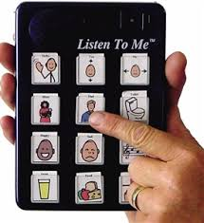
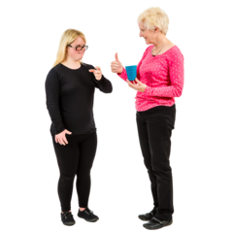
What are Your Rights?
You have the right to
Communicate in a way that suits you.
People should communicate with you in ways you understand and can reply.
ddwa.org.au

Slide 16
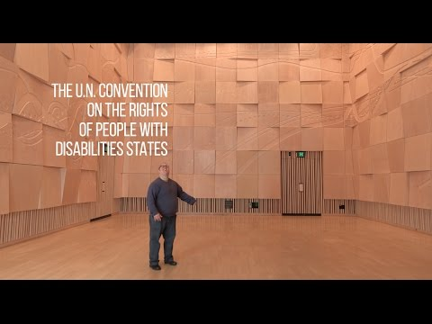

Slide 17

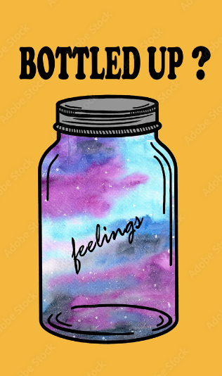
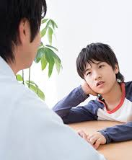
Speaking about Our Feelings
Speaking about how we are feeling can help us to self advocate.
It's not good to bottle our feelings.
Speaking up about how we are feeling can be part of self advocacy.
Let's have a look at some feelings now........
ddwa.org.au

Slide 18

What makes you feel HAPPY?
_______________________________________________________________________________________________________________________________________________________________________________________________________________________________________________________________________________________________________________________________________________________________
ddwa.org.au

Slide 19
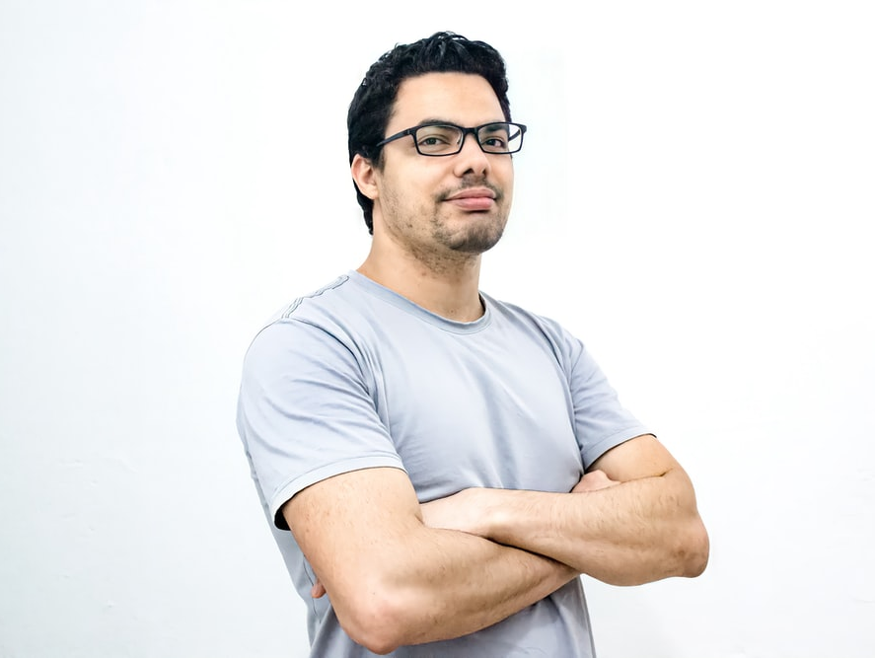
What makes you feel CONFIDENT?
_______________________________________________________________________________________________________________________________________________________________________________________________________________________________________________________________________________________________________________________________________________________________
ddwa.org.au

Slide 20
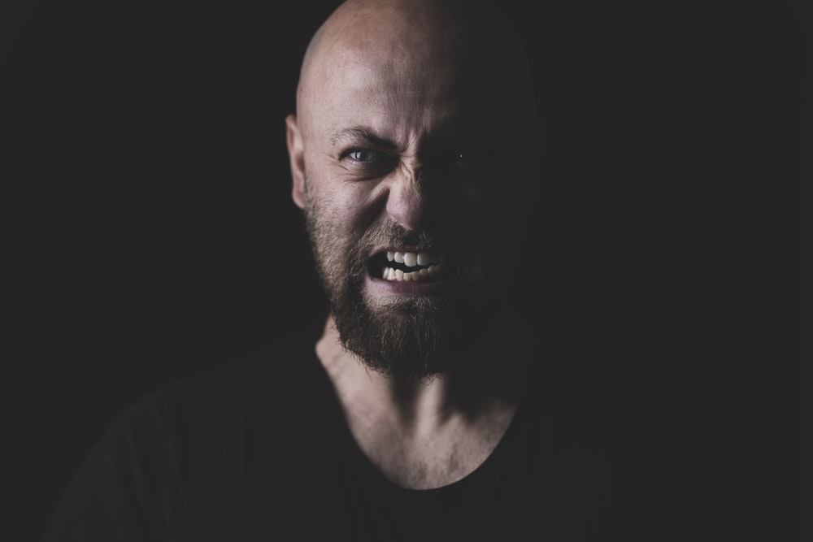
What makes you feel ANGRY?
_______________________________________________________________________________________________________________________________________________________________________________________________________________________________________________________________________________________________________________________________________________________________
ddwa.org.au

Slide 21
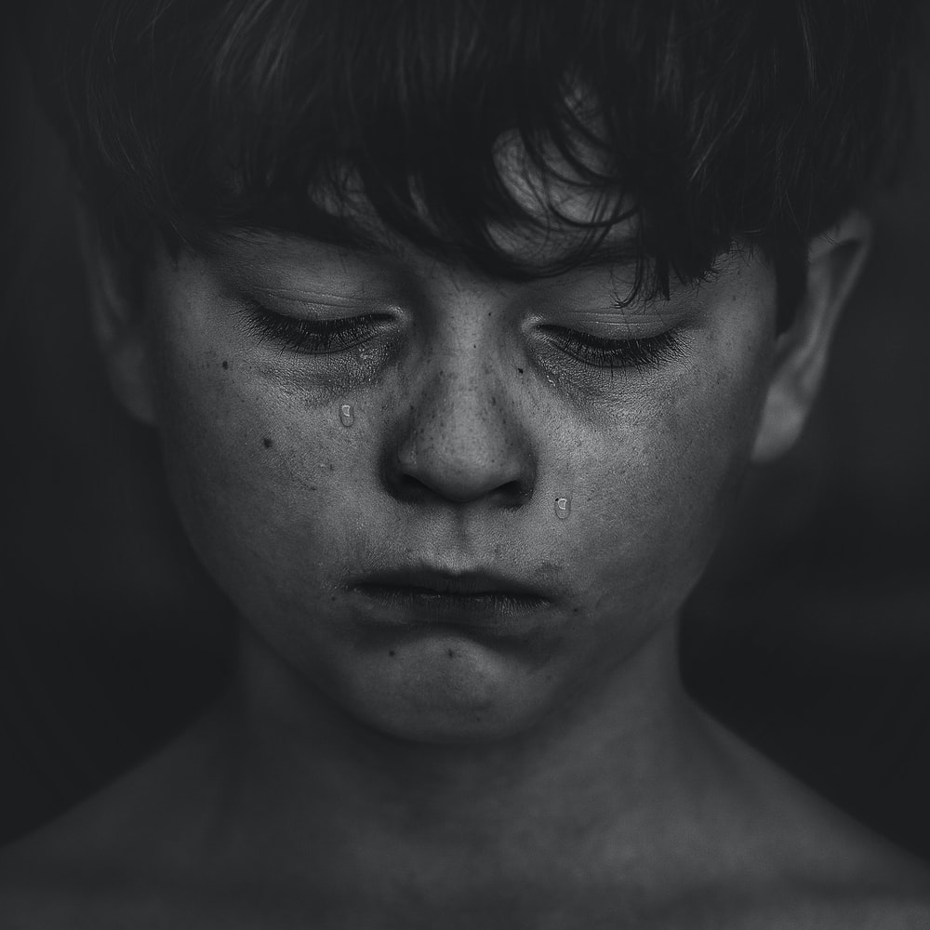
What makes you feel SAD?
_______________________________________________________________________________________________________________________________________________________________________________________________________________________________________________________________________________________________________________________________________________________________
ddwa.org.au

Slide 22

What makes you feel FRUSTRATED?
__________________________________________________________________________________________________________________________________________________________________________________________________________________________________________________________________________________________________________________________________________________________________________________________
ddwa.org.au

Slide 23
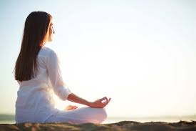
What makes you feel CALM?
_______________________________________________________________________________________________________________________________________________________________________________________________________________________________________________________________________________________________________________________________________________________________
ddwa.org.au

Slide 24






Knowing Your Feelings
Can help you know if your rights have been breached.
Which of these feelings might tell you your rights have not been respected?
Happy
Angry
Confident
Sad
Calm
Frustrated
ddwa.org.au

Slide 25
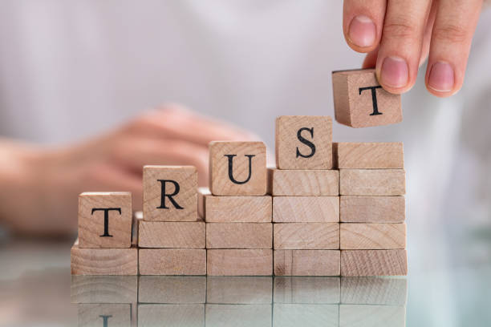
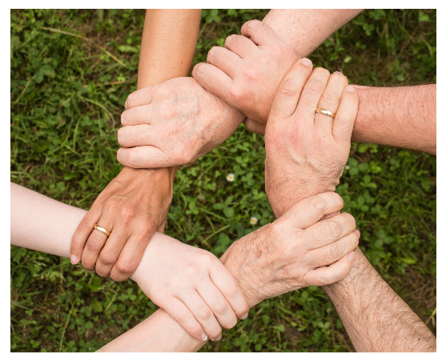
Who do you Trust ?
You can talk about your feelings with someone you trust.
A person you can trust is a person;
You feel safe with
You know will tell you the truth
You know will support you
ddwa.org.au

Slide 26
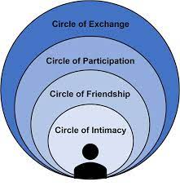
Circles of Support- the closer in, the more they are someone you trust who could support you.
Social Media Friends
Community members
Support workers
Your friends
Your family
Carers
ddwa.org.au

Slide 27

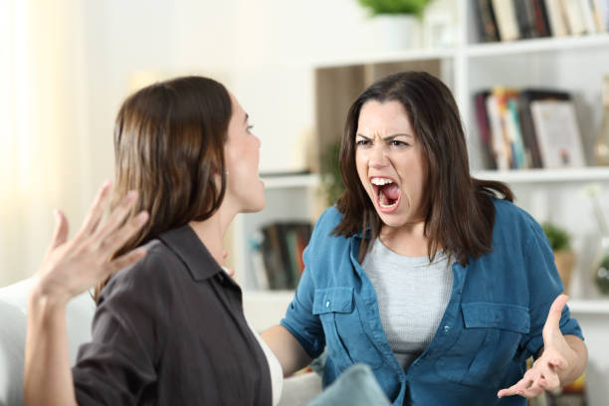
When telling your feelings, you need to say them assertively
It means not being PASSIVE
Passive is
Not speaking up for yourself
Things happen to you that you have no control over
And not being aggressive
Aggressive is
Pushing your views too hard
Shouting at people
Bullying people
ddwa.org.au

Slide 28
Responsibilities
You need to be RESPONSIBLE by allowing others THEIR RIGHTS too.
Help yourself and others to be safe
Don't hurt others
Treat others with respect
Obey the law
ddwa.org.au

Slide 29


What to do if your rights are breached?
Say your rights
Speak up about what you need
Say your choices
Ask someone to support you (to advocate for you)
ddwa.org.au

Slide 30
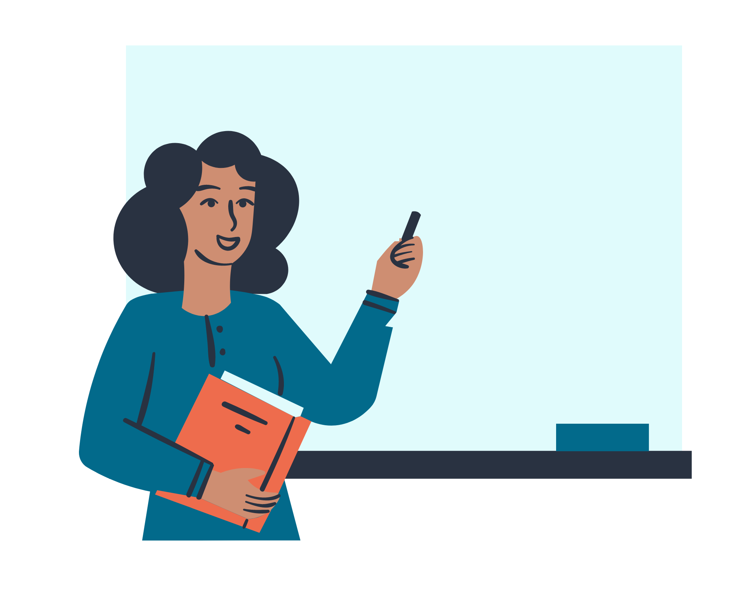
Let’s look at some examples…
ddwa.org.au

Slide 31
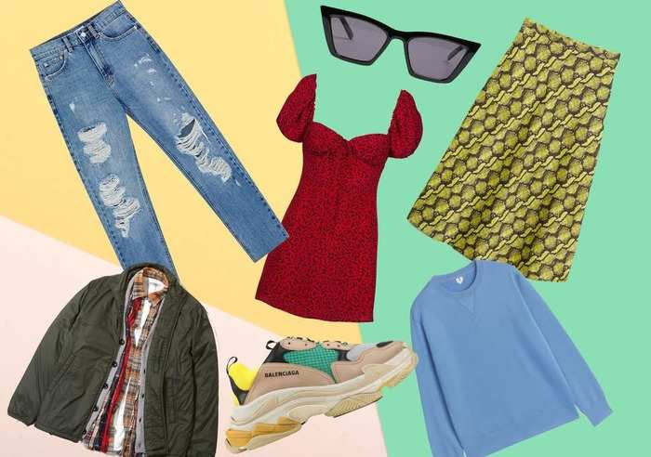
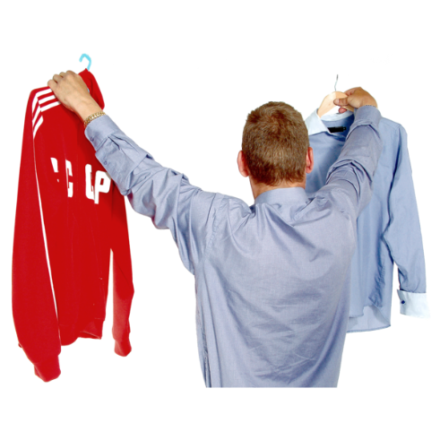
Your Mum / Dad choose some clothes
for you that you don’t like?
How do you feel?
Which of your rights was breached?
What can you do ?
ddwa.org.au

Slide 32
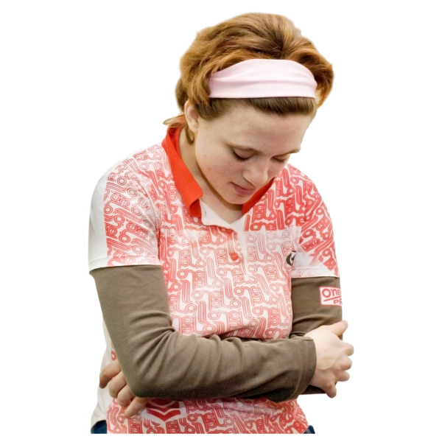
A teacher allows everyone to play a game except you
How would you feel?
Which of your rights was breached?
What could you do?
ddwa.org.au

Slide 33
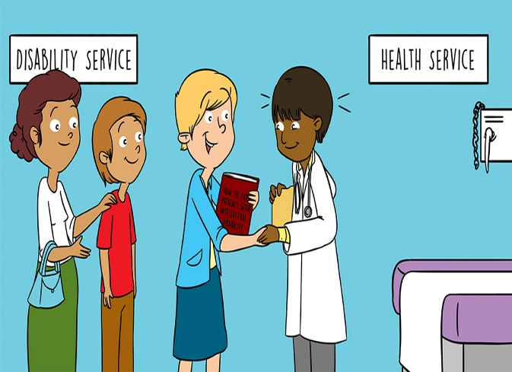
A doctor wouldn't let you use your communication aid, and only spoke to your carer
How would you feel?
Which of your rights was breached?
What could you do?
ddwa.org.au

Slide 34
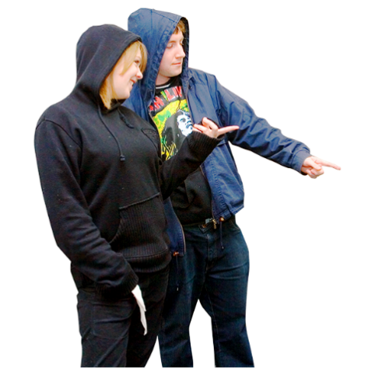
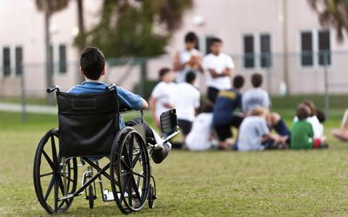
A classmate called you names and puts you down because of how you look
How would you feel?
Which of your rights was breached?
What could you do?
ddwa.org.au

Slide 35
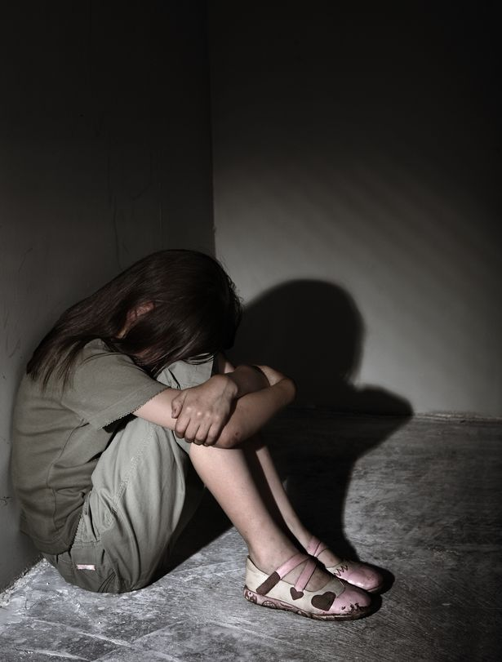
Someone locked you in a cupboard
How would you feel?
Which of your rights was breached?
What could you do?
ddwa.org.au

Slide 36
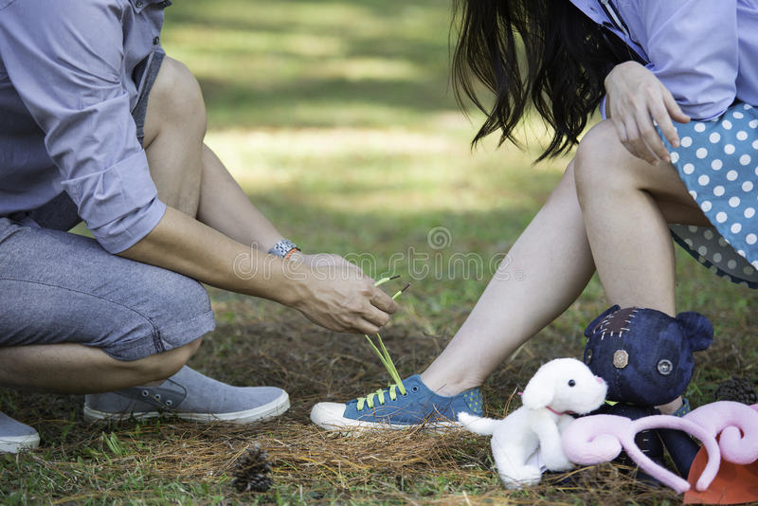
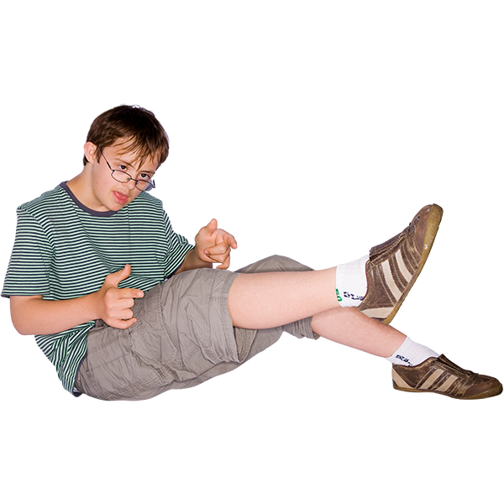
A support person put your shoes on for you when you can do it yourself
How would you feel?
Which of your rights was breached?
What could you do?
ddwa.org.au

Slide 37
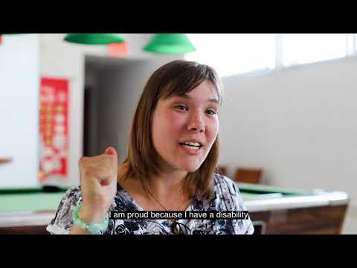
ddwa.org.au

