Slide 1

DDWA Self Advocacy Program
Session 1. What is Self Advocacy?
ddwa.org.au

Slide 2

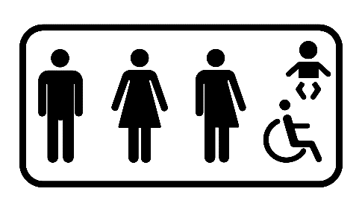


Introduction
Welcome Everyone
Toilets
Emergency
Break
ddwa.org.au

Slide 3
What will we learn in this session?
Who is DDWA ?
What makes a good meeting
Group understandings
Introductions
Aims of the course
Benefits of the course
What is Self Advocacy ?
ddwa.org.au

Slide 4
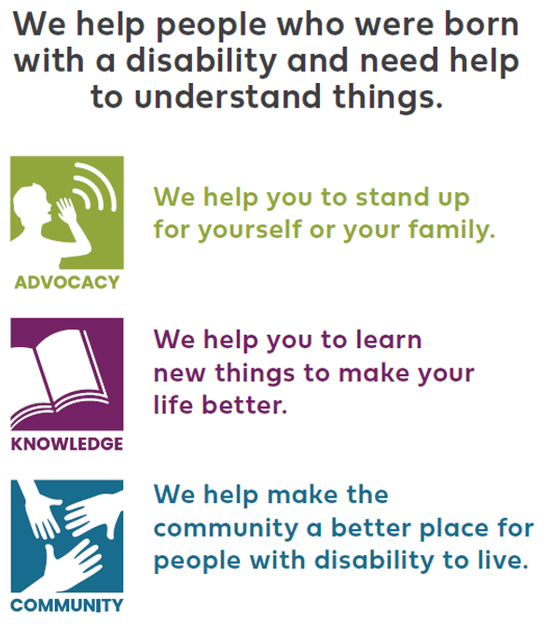
Who is DDWA ?
ddwa.org.au
Notes:
DDWA- Supporting people with developmental disabilities and their families since 1985
Introduce presenters

Slide 5
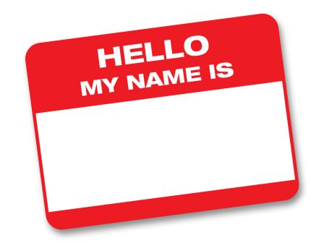
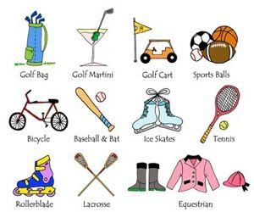
Getting to Know Everyone…
Tell the group/person next to you - what your name is.
Tell the group/person next to you - something you enjoy doing.
ddwa.org.au

Slide 6

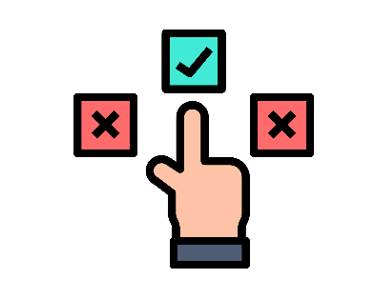

The Aim of the Course
Speak up for yourself.
Think about what you want your life to be like.
Make decisions about your life
There is a booklet to help you through this course. It is yours to keep.
ddwa.org.au

Slide 7
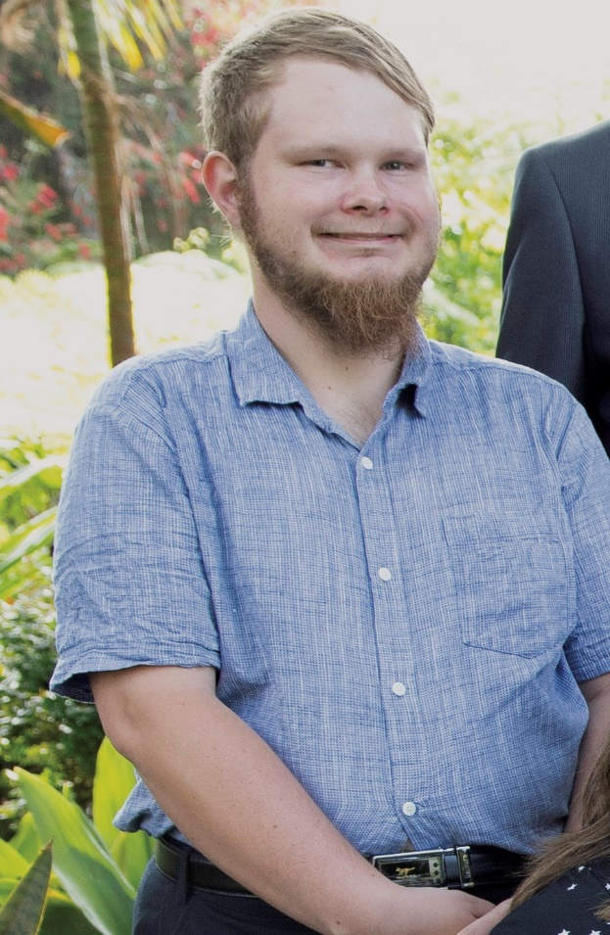
How this course helped Justin
Justin said that he feels confident in speaking up for himself.
He has learned to use the skills he learned in this course to help others.
ddwa.org.au

Slide 8
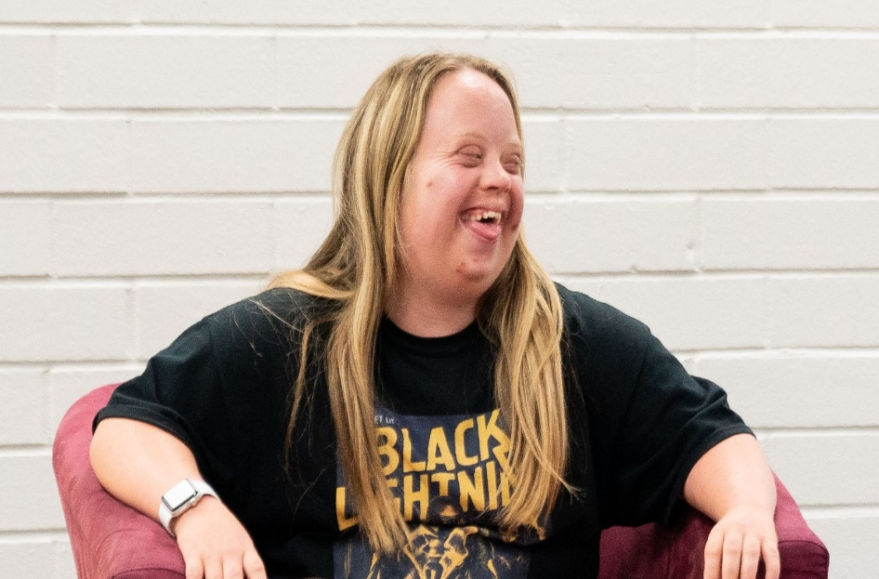
How this course helped Lauren
Lauren said that she has learned she likes encouraging others in their activities.
ddwa.org.au

Slide 9
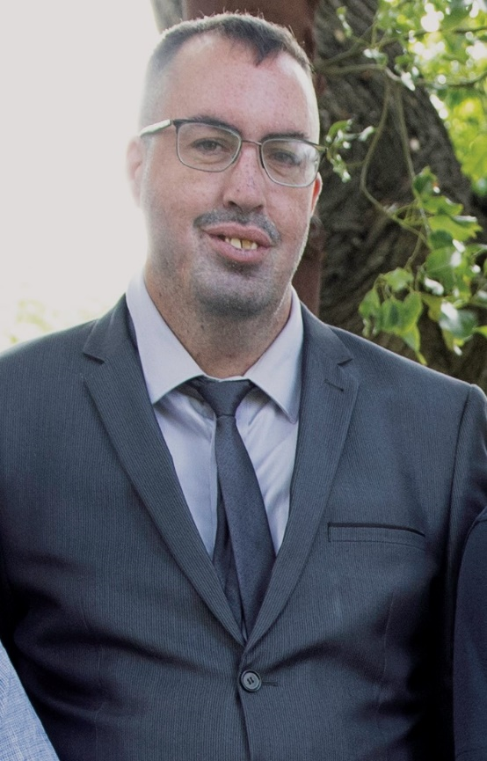
How this course helped John
John said that self-advocacy has changed his life for the better.
He now feels he has a purpose in helping other people with disabilities to know about their rights.
ddwa.org.au

Slide 10
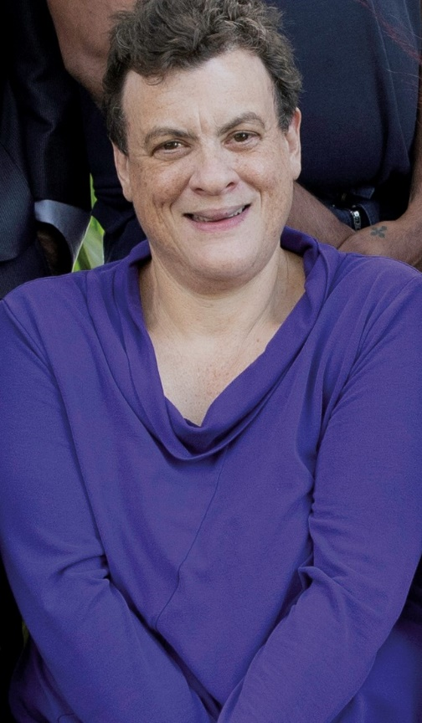
How this course helped Michelle
Michelle said that self-advocacy has helped her to speak up to her Dad about the things that are important to her in her life.
She now has a partner and wants to start her own business.
ddwa.org.au

Slide 11
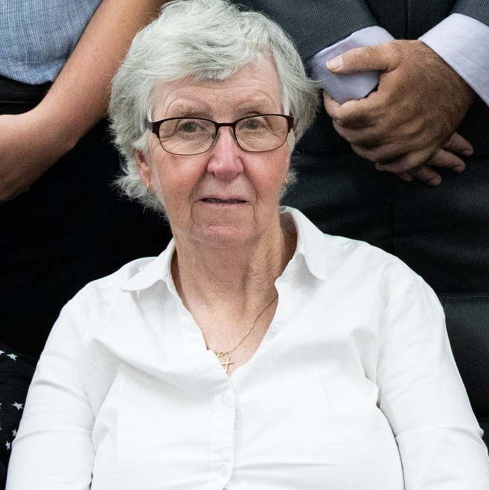
How this course helped Georgie
Georgie said that self-advocacy has helped her to say what she needs to government departments and as a tenant in her house.
ddwa.org.au

Slide 12
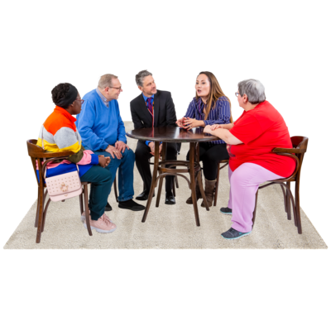
What shall we do to make this a
good meeting?
How should we work together?
ddwa.org.au

Slide 13

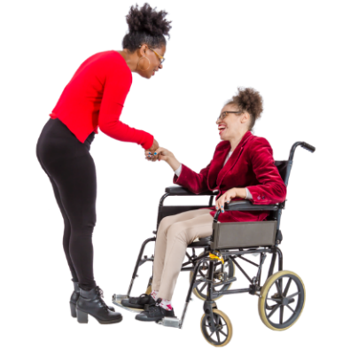
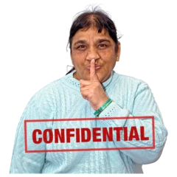
How to have a Good Meeting
Take turns speaking
Listen to others
Respect others
Feel comfortable and safe
Confidentiality
ddwa.org.au

Slide 14


What is Self Advocacy?
ddwa.org.au

Slide 15
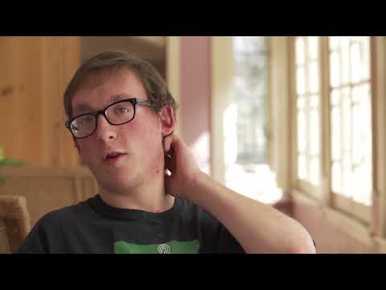
ddwa.org.au

Slide 16

Self Advocacy is...
Speaking up for yourself
You may do this through speech, gestures, signing, writing, drawing or with a communication device.
ddwa.org.au

Slide 17

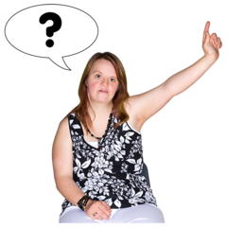
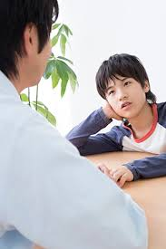
Self Advocacy is...
Making your own choices and decisions
Asking questions
Telling people how you are feeling
ddwa.org.au
Notes:
Ask participants of examples in their lives of each of the points in the slide

Slide 18
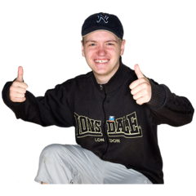

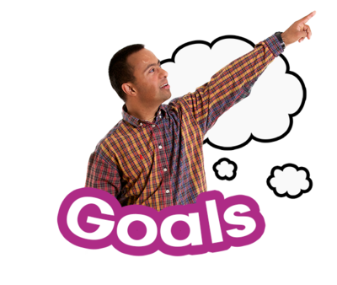
Being a Self Advocate can help you to:
Feel good about yourself.
Make choices and decisions.
Speak up about and solve problems.
Have control of your life.
ddwa.org.au

Slide 19
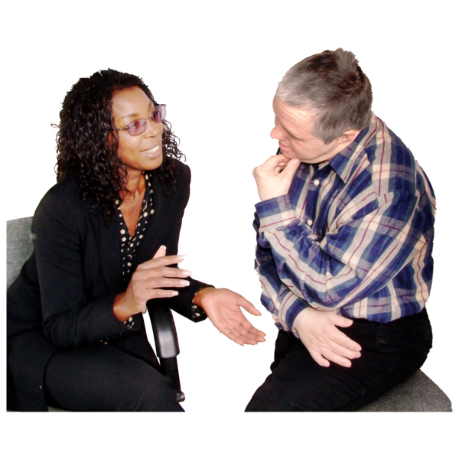
The most effective way to Self Advocate is
By being ASSERTIVE.
Sticking up for yourself; but being respectful.
Getting your point across without being rude, critical or blaming.
Using "I" statements – I feel, I would like, I need, I want.
ddwa.org.au
Notes:
Speak about the difference between assertive and being passive and being aggressive

Slide 20
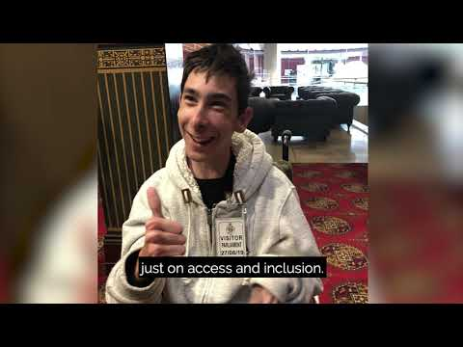
ddwa.org.au

Slide 21

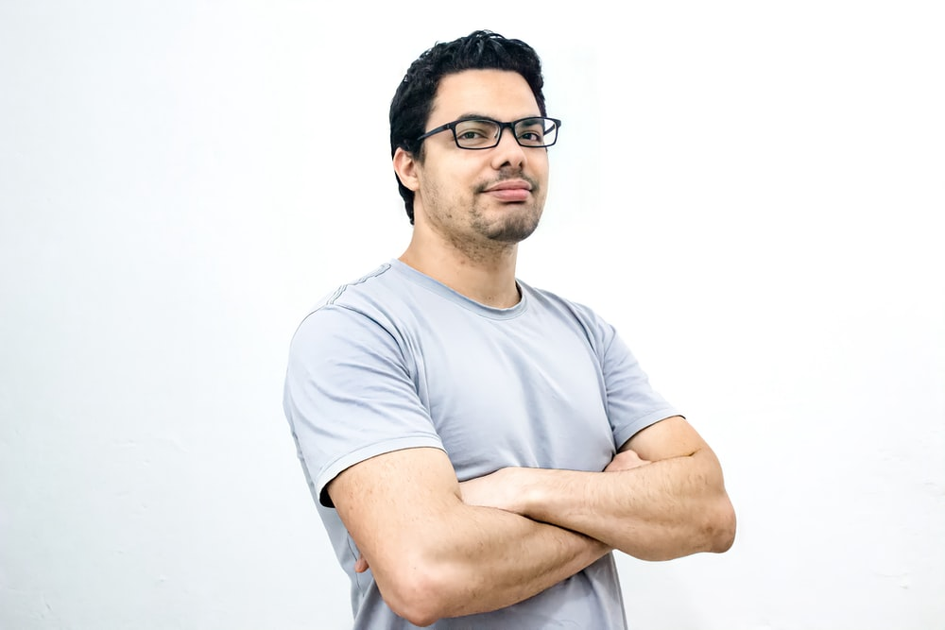
So HOW can you self-advocate?
To self advocate you need to:
Know your rights.
Feel confident to speak up.
ddwa.org.au

Slide 22
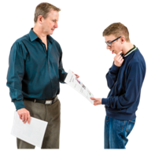


                3. Ask for help from someone you trust.
                Decide what you need and
                want.
                5. Ask for it.
ddwa.org.au

Slide 23

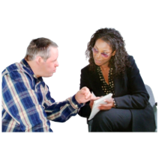
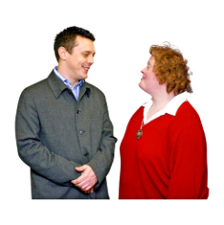
Think about the issue.
See who could support you.
Speak up (with an advocate if you need).
Plan what to say (and practice if you need).
ddwa.org.au

Slide 24

Self Esteem and Confidence
What is Self Esteem?
What is confidence?
How can you build your confidence?
ddwa.org.au

Slide 25



Building Confidence and Self Esteem
Remember the things that make you happy.
Count the things you've achieved/ done well at.
Remember your gifts and talents.
ddwa.org.au

Slide 26
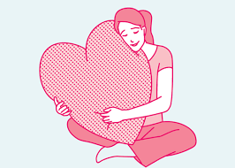
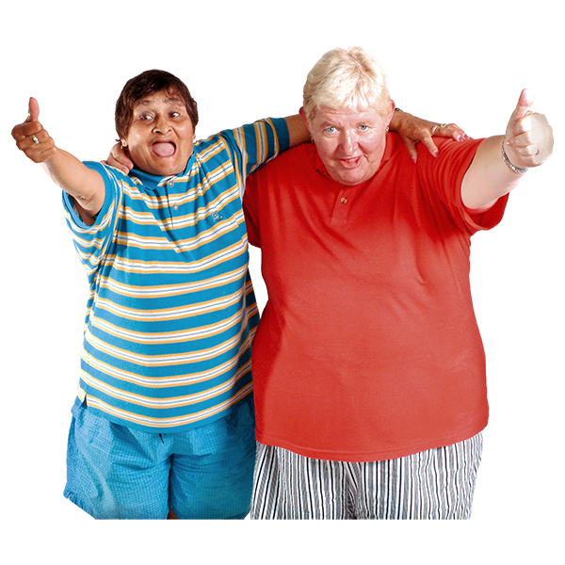
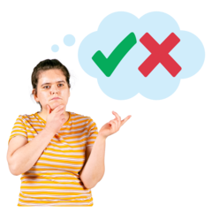
Be kind to yourself = be your own best friend.
Know your rights.
Build positive relationships –know who you can trust.
Make your own choices.
ddwa.org.au

Slide 27
Examples of Self Advocacy in the group
ddwa.org.au
Notes:
Ask the group to give examples of situations where they have had to self advocate. Have some examples ion case they don't.

Slide 28

ddwa.org.au

